Slide 1
The Transformation Equation: Discover the 5 Foundational Components of Transformational Leadership
Mack and Ria Story, Top Story Leadership
February 25, 2019, 2:00pm EST

Slide 2
About Mack and Ria Story:
Mack Story has logged over 11,000 hours leading teams through organizational change. He is the author of the extremely popular Blue-Collar Leadership® Series.
Ria Story is an author, TEDx speaker, and expert in leadership and life skills for women. Ria has nearly 20 years of experience in leadership and management.
Mack and Ria co-founded Top Story Leadership in 2008, are certified leadership speakers and trainers, and have published 22 books on leadership development and personal growth.
Highlights for them have been:
  Helping train 20,000 Guatemalan Leaders with John Maxwell
  Speaking at Yale University
  Offering leadership development support for the U.S. Military,
  Chick-fil-A, Auburn University, Chevron, and many other organizations

Slide 3

What is Transformational Leadership?
Why do we need Transformation? The 3 Dilemmas
What is The Transformation Equation?
What happens transformational components are missing?

Slide 4
Transformation Isn’t Easy
“85% of companies have undertaken a transformation during the past decade.
Nearly 75% of those fail to improve business performance, either short term or long term.”
Harvard Business Review, Changing Minds, June 2018

Slide 5
Transformational Leadership

Slide 6

Transformational Leadership: What is it?
Leadership is Influence
Transformation is a “Lasting Difference in Form,” not short term change
Transformational leadership is influencing people and organizations in a way that results in positive transformation

Slide 7
Why Do We Need Transformation?
The 3 Dilemmas

Slide 8

The Engagement Dilemma
Leaders are frustrated with lack of employee engagement; employees are frustrated with lack of leader engagement
Engagement at all levels is the key to reducing turnover, costs, and frustrations for organizational leaders
Disengaged employees are a symptom of disengaged leaders at one or more levels in the organization

Slide 9
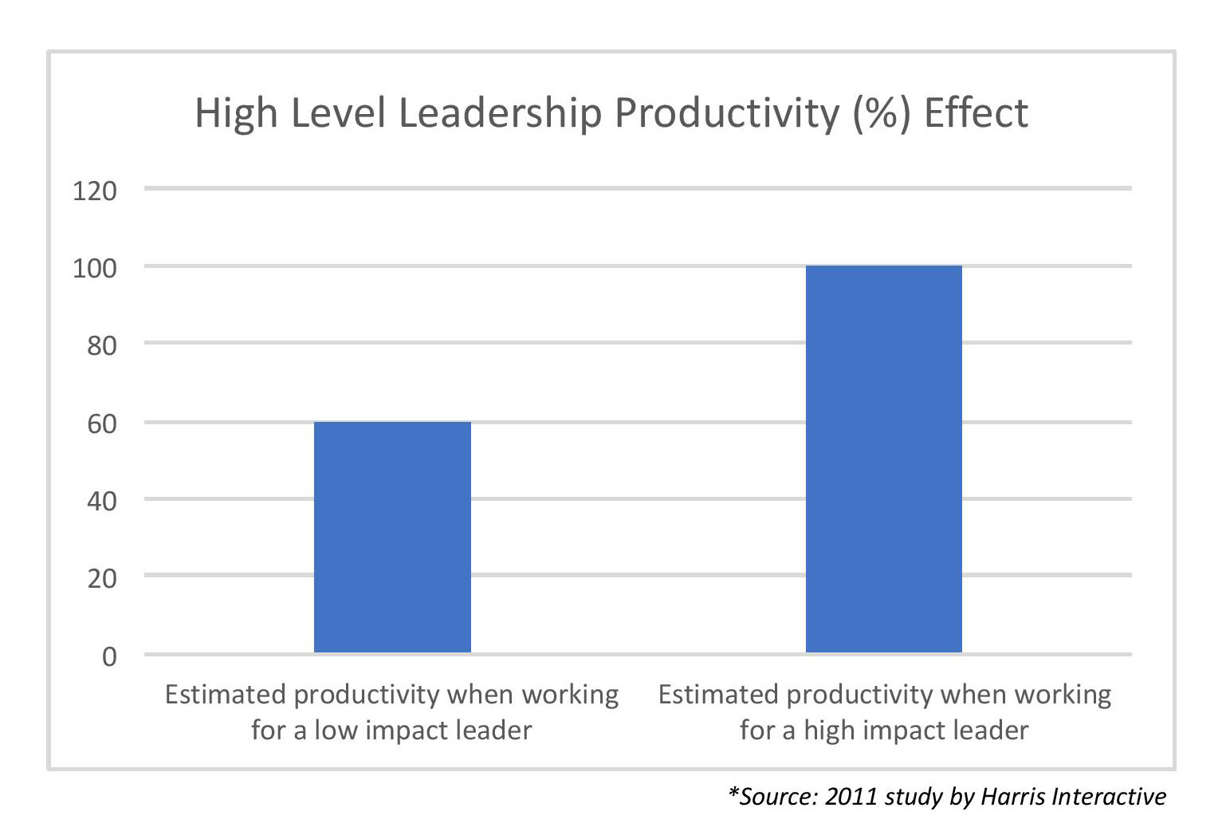
Engagement Starts at the Top
Research shows 79% of employees are, on average, 40% more productive and engaged when working for a better leader.

Slide 10

The Retention Dilemma
The competition wants more than your customers: They also want your people.
In addition to salary, high performance team members want growth and development opportunities that will help them become more successful personally and professionally.
High impact leaders understand they must offer more development opportunities in order to become the employer of choice in their area and in their industry.

Slide 11
Culture Vs. Strategy
“Culture doesn’t just eat strategy for breakfast; it eats everything.”
David Katz, President of Coca-Cola Consolidated

Slide 12

The Turnover Dilemma
We primarily interview, select, and hire employees based on the competency of the candidate. But, we are usually terminating employees based on character.
Employees are hired for what they know, but fired for who they are. Performance problems are almost exclusively a character issue.
Most training and development is focused on developing competency, not character.

Slide 13
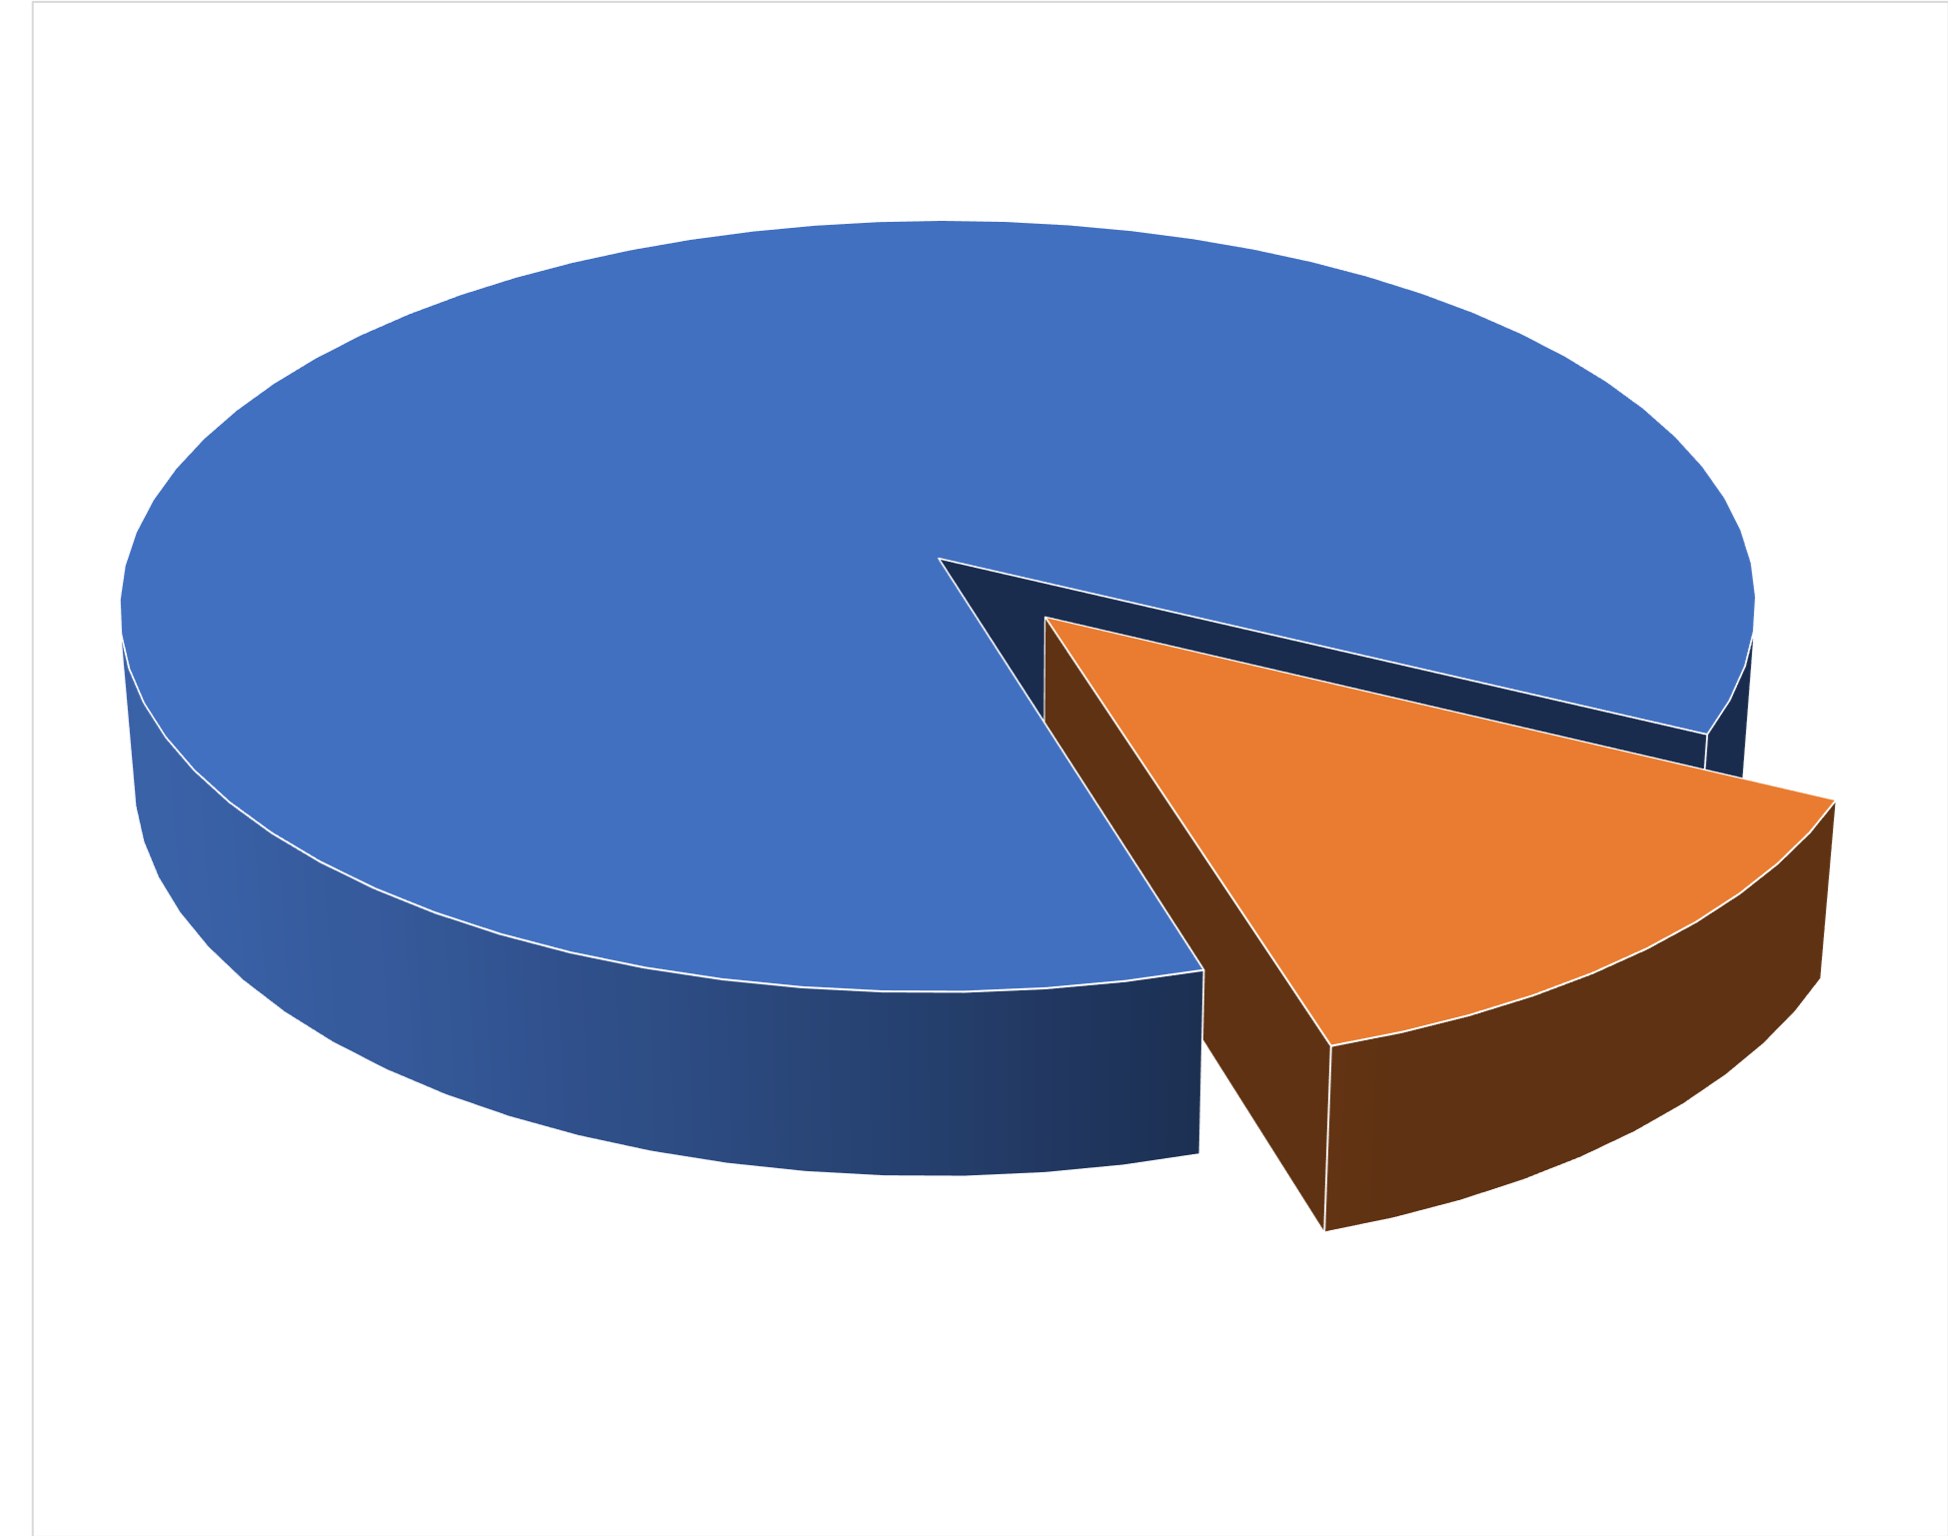
Character Leverages Competency
90% of our results as individuals and organizations is determined by character.
Character 90%
Competency 10%

Slide 14
What Is The Transformation Equation?

Slide 15
The Transformation Equation
Leadership Development
Buy-In
Unifying Purpose
Competency
Execution
Transformation
Buy-In
Unifying Purpose
Competency
Execution
Leadership Development
Buy-In
Buy-In
Leadership Development
Copyright © 2019 Ria Story and Mack Story. All Rights Reserved.

Slide 16
The Transformation Equation
Leadership Development
Buy-In
Unifying Purpose
Competency
Execution
Transformation
Buy-In
Unifying Purpose
Competency
Execution
Leadership Development
Buy-In
Buy-In
Leadership Development
Copyright © 2019 Ria Story and Mack Story. All Rights Reserved.

Slide 17
The Transformation Equation
Leadership Development
Buy-In
Unifying Purpose
Competency
Execution
Transformation
Buy-In
Unifying Purpose
Competency
Execution
Frustration
Leadership Development
Buy-In
Buy-In
Leadership Development
Copyright © 2019 Ria Story and Mack Story. All Rights Reserved.

Slide 18
The Transformation Equation
Leadership Development
Buy-In
Unifying Purpose
Competency
Execution
Transformation
Leadership Development
Unifying Purpose
Competency
Execution
Buy-In
Competency
Execution
Buy-In
Frustration
Leadership Development
Unifying Purpose
Competency
Execution
Copyright © 2019 Ria Story and Mack Story. All Rights Reserved.

Slide 19
The Transformation Equation
Leadership Development
Buy-In
Unifying Purpose
Competency
Execution
Transformation
Leadership Development
Unifying Purpose
Competency
Execution
Buy-In
Competency
Execution
Buy-In
Frustration
Leadership Development
Unifying Purpose
Competency
Execution
Resistance
Copyright © 2019 Ria Story and Mack Story. All Rights Reserved.

Slide 20
The Transformation Equation
Leadership Development
Buy-In
Unifying Purpose
Competency
Execution
Transformation
Buy-In
Unifying Purpose
Competency
Execution
Frustration
Competency
Leadership Development
Unifying Purpose
Competency
Execution
Competency
Execution
Resistance
Leadership Development
Buy-In
Unifying Purpose
Competency
Execution
Buy-In
Competency
Execution
Copyright © 2019 Ria Story and Mack Story. All Rights Reserved.

Slide 21
The Transformation Equation
Leadership Development
Buy-In
Unifying Purpose
Competency
Execution
Transformation
Buy-In
Unifying Purpose
Competency
Execution
Frustration
Competency
Leadership Development
Unifying Purpose
Competency
Execution
Competency
Execution
Resistance
Leadership Development
Buy-In
Unifying Purpose
Competency
Execution
Confusion
Buy-In
Competency
Execution
Copyright © 2019 Ria Story and Mack Story. All Rights Reserved.

Slide 22
The Transformation Equation
Leadership Development
Buy-In
Unifying Purpose
Competency
Execution
Transformation
Buy-In
Unifying Purpose
Competency
Execution
Frustration
Buy-In
Competency
Execution
Leadership Development
Unifying Purpose
Competency
Execution
Competency
Resistance
Leadership Development
Buy-In
Competency
Execution
Confusion
Buy-In
Execution
Leadership Development
Unifying Purpose
Leadership Development
Buy-In
Execution
Buy-In
Copyright © 2019 Ria Story and Mack Story. All Rights Reserved.

Slide 23
The Transformation Equation
Leadership Development
Buy-In
Unifying Purpose
Competency
Execution
Transformation
Buy-In
Unifying Purpose
Competency
Execution
Frustration
Buy-In
Competency
Execution
Leadership Development
Unifying Purpose
Competency
Execution
Competency
Resistance
Leadership Development
Buy-In
Competency
Execution
Confusion
Buy-In
Execution
Leadership Development
Unifying Purpose
Leadership Development
Buy-In
Execution
Buy-In
Anxiety
Copyright © 2019 Ria Story and Mack Story. All Rights Reserved.

Slide 24
The Transformation Equation
Leadership Development
Buy-In
Unifying Purpose
Competency
Execution
Transformation
Buy-In
Unifying Purpose
Competency
Execution
Frustration
Buy-In
Competency
Leadership Development
Unifying Purpose
Competency
Execution
Resistance
Leadership Development
Buy-In
Competency
Execution
Confusion
Buy-In
Leadership Development
Buy-In
Unifying Purpose
Execution
Buy-In
Execution
Anxiety
Leadership Development
Unifying Purpose
Leadership Development
Buy-In
Unifying Purpose
Competency
Buy-In
Competency
Copyright © 2019 Ria Story and Mack Story. All Rights Reserved.

Slide 25
The Transformation Equation
Leadership Development
Buy-In
Unifying Purpose
Competency
Execution
Transformation
Buy-In
Unifying Purpose
Competency
Execution
Frustration
Buy-In
Competency
Leadership Development
Unifying Purpose
Competency
Execution
Resistance
Leadership Development
Buy-In
Competency
Execution
Confusion
Buy-In
Leadership Development
Buy-In
Unifying Purpose
Execution
Buy-In
Execution
Anxiety
Leadership Development
Unifying Purpose
Leadership Development
Buy-In
Unifying Purpose
Competency
Buy-In
Competency
Stagnation
Copyright © 2019 Ria Story and Mack Story. All Rights Reserved.

Slide 26
Transformation Takes Time
Leaders often overestimate the impact of a single event, and many leaders also underestimate the impact of consistent growth over time, the process.
Without a transformational leader,
there won’t be a cultural transformation.

Slide 27
Thank you!
Ria and Mack Story, Facilitators
Upcoming LearnNow Transformational Leadership
https://www.td.org/events/learnnow-transformational-leadership
Alexandria, VA April 11-12

