Slide 1
Coaching for Behavior Change
Coaching is an effective tool for developing people and producing positive behavior change because it aligns with almost any learning theory or learning principle. Because coaching is a just-in-time, customized approach to development, it is far more cost-effective than more prevalent one-size-fits-all approaches to learning.
So, what if you already understand the potential benefits of coaching—to coachees and coaches alike—but are unsure of how to do it well? Increase the effectiveness of your coaching interactions with the author of ATD’s 10 Steps to Successful Coaching.
Following this webcast, you will be able to:
• Use coaching activities and questions observed in three mini coaching demonstrations.
• Ensure that your coaching interactions incorporate evidence-based principles about how people make behavioral changes in their lives and work.

Slide 2
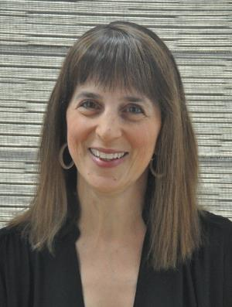
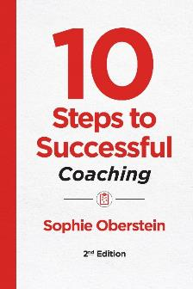
Coaching for Behavior Change
Sophie Oberstein

Slide 3
What is Coaching?
An opportunity for an employee to step out of their day-to-day work experience to explore ways to become more fulfilled and effective at work
A way of creating positive behavior change through a two-way, accountable relationship

Slide 4
Coaching benefits (to the coach)
Developing a new set of leadership skills
Fulfilling a responsibility of my managerial position
Enhancing working and personal relationships
Becoming a better communicator
Helping the people I coach at work become more engaged and productive
Helping others grow professionally or personally

Slide 5





What makes coaching an effective development tool?
Coaching
Adult learning theory
Microlearning
Neuroscience
Constructivism
Growth mindset

Slide 6

COACHING DEMO 1:
PEAK EXPERIENCE
Talk about a time when you were happy to get up in the morning – when things were going well for you
Can be work related or non-work related
Can be recent or in the past

Slide 7
Ask
What’s most important?
What brings you joy?
What was your greatest accomplishment of recent years?
Whose opinion matters?
What legacy do you want to leave?
What’s your why? / Why are you doing this work?

Slide 8
Coaching principles
People act on what’s important to them
People have their own best answers
People need to be helped to notice
People grow within an accountable relationship
People grow within a defined relationship

Slide 9
Defining the relationship
Clearly define roles
Establish agreements / requests / ground rules
Agree on logistics
Check how the person is feeling about being coached
Notes:
9

Slide 10
Speed coaching
Can you give 3 sentences about the situation? Can you boil that down to 7 words?
What would you like to have happen?
What needs to happen?
Can you?
Will you?

Slide 11
Accountability
Have coachee re-cap
Check comfort level and motivation to do what they agreed to
Solidify who is doing what by when?
Position it as a “short-term experiment”
Give them permission to fail

Slide 12
Question generator
Column 1 | Column 2 | Column 3
What’s | happening possible working needed your wish your role the sticking place not being said your choice important next | for you? right now? from this perspective? when you get/do that? in the big picture? for/in that meeting/interaction? for/in your team? as a leader? in five years?
Who | is responsible? do you need to be?
How | will you do/get that? will this work? do you feel? can you be [adjective]?

Slide 13

Watch out for…
Questions for your own curiosity
Advice disguised as a question
Leading questions
Questions that are a trap
Close-ended questions
Run-on questions

Slide 14
Some noticing questions
How much of your head/brain space is this occupying?
Where do you feel this in your body?
If you were watching this happen (fly on the wall), what would you be thinking?
What would you tell a friend who was in your situation?
How could you think about this differently to move forward?
What’s happening?
What are the emotions surrounding the issue right now?
What is your gut / intuition telling you?
What are you learning about yourself right now?
Notes:
14

Slide 15

Helping to notice
Ask questions
Provide feedback
Observe and offer verbatims
Provide recognition
Provide checklists / demos / models of what good looks like
Notes:
15

Slide 16
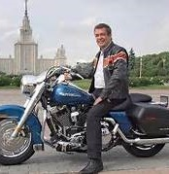
I never cease to be amazed at the power of the coaching process to draw out the skills or talent that was previously hidden within an individual, and which invariably finds a way to solve a problem previously thought unsolvable.
“
“
John Russell
Former Managing Director,
Harley Davidson Europe

