Slide 1

How to Recertify Your
APTD or CPTD
May 20, 2021
1 PM ET
Notes:
Thanks Regina, I’m Holly Batts, Associate of the ATD Certification Institute. Welcome to today’s webinar How to Recertify Your APTD or CPTD. My colleague, Sue Kaiden, is your presenter today. Sue is Senior Project Manager for the ATD Certification Institute and she handles all things related to recertification.
When you signed up for this webcast, we asked you to submit questions you were hoping would be covered today. When Sue prepared her presentation, she reviewed your questions and will provide answers to many of your queries during the webinar.
However, if you have questions during the presentation, feel free to type them in the chat box as you think of them. I will be monitoring the chat box and will save your questions for Sue to address at the end of the presentation.
And yes, you will get a link to a pdf of these slides and webcast recording tomorrow.
So, without further ado, here’s Sue

Slide 2
AGENDA
Talent Development Capability Model
Recertification Basics
New Capabilities Requirement
Recertification Categories
Certification Portal
Resources
Questions
Notes:
Hi Everyone, I’m Sue Kaiden, and as Holly mentioned, I handle the recertification process for the ATD Certification Institute. Here’s what I’m planning to cover today:
1st I will provide a little bit of background about the Talent Development capability model. We’re not going to go into great detail about the model, but you’ll get a few basics.
2nd We’re going to talk about Recertification basics– general rules that apply to all professional development activities
3rd We’re going to discuss the New Capabilities requirement that is now in force for those recertifying after May 1, 2021.
4th We’re then going to talk about the categories in which you can earn recertifcation points.
Finally, we’ll talk about the new certification portal and where you can find resources to help you in your recertification journey.

Slide 3
Talent Development Capability Model
Notes:
First, a little background on the Talent Development Capability Model adopted last year

Slide 4
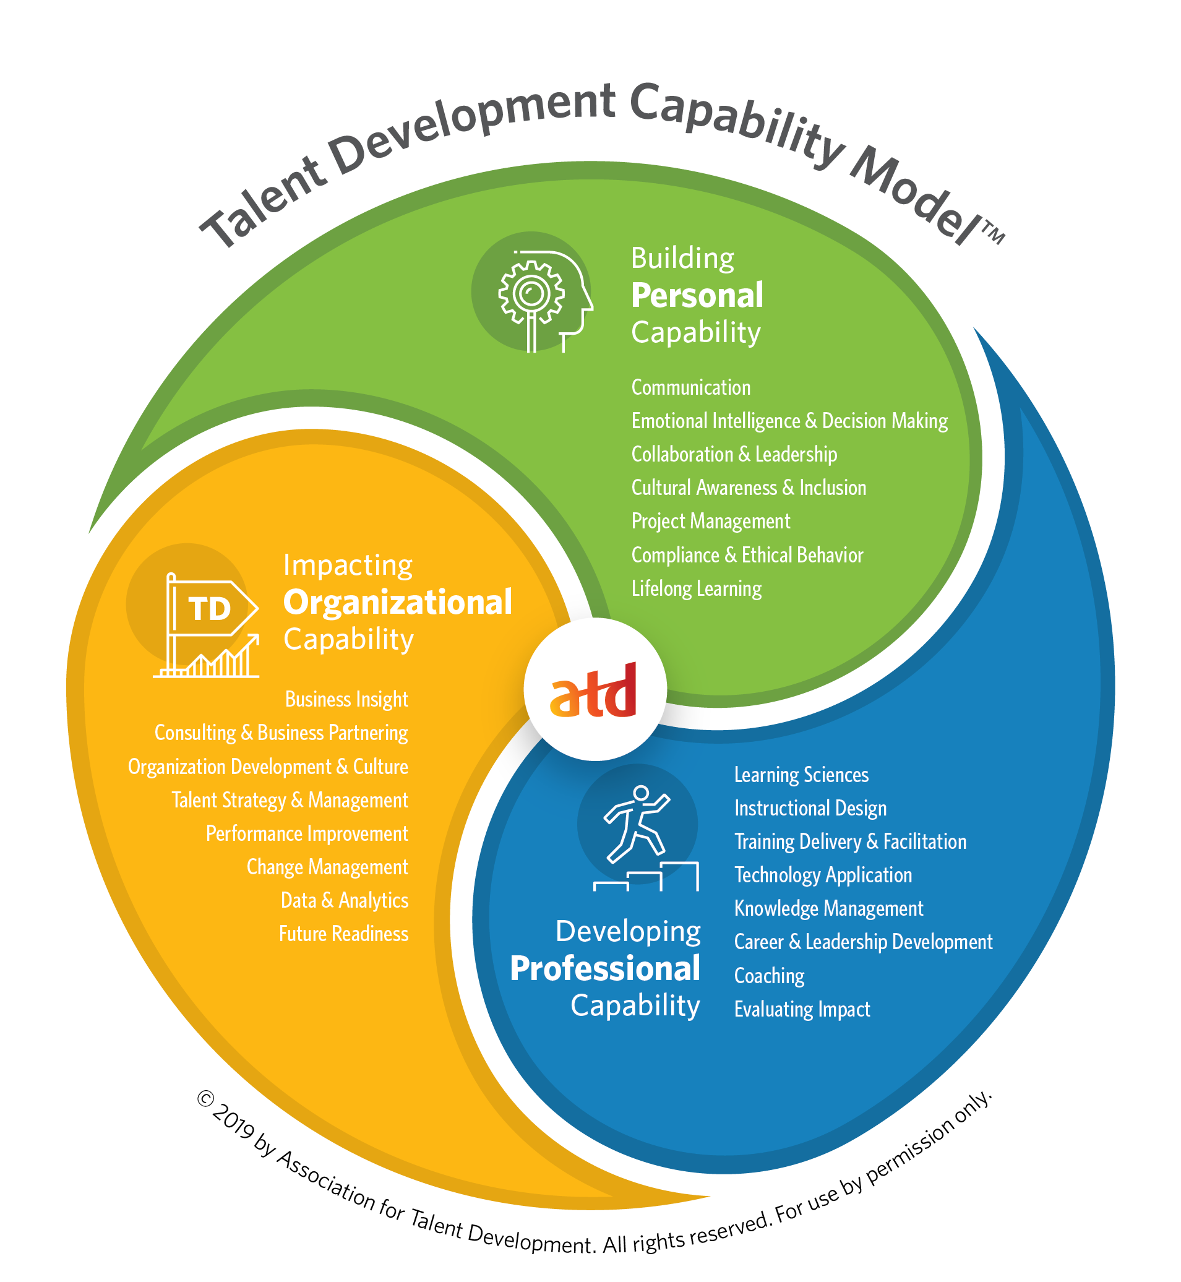
Certifications Grounded in Research
Tied directly to the Talent Development Capability Model
Exam Content developed by analyzing responses from target audience
Exams cover a subset of knowledge and skills in capability model
Notes:
The Talent Development Capability Model adopted in early 2020 was based on extensive industry research done in 2019 (many of you likely participated in the survey).
The Capability model encompasses three domains of practice that outline the personal, professional and organizational capabilities required for talent development professionals to be successful in the field.
These domains are then broken into twenty-three Capabilities encompassing 188 knowledge and skill statements that outline what talent development professionals need to KNOW and DO in order to be effective.
The APTD and CPTD certification exams are based on a SUBSET of the knowledge and skill statements contained in the model that were deemed to be most important at specific points in a career.

Slide 5
Capability Webcast
Notes:
The capabilities included in each of the three domain areas are shown on this diagram. I know the print is small. For a deeper dive into the model, visit the interactive site or view one of the webcasts we held last year that went into detail about the model.
Chat out the links:
Links: www.td.org/capability-model
Webcast: https://webcasts.td.org/webinar/3611

Slide 6
Competency Model vs. Capability Model
Area of Expertise (AOE) / Foundational – 2013 Model |  | Capability Area – 2019 Model + New Capability Areas
Instructional Design |  | Instructional Design
Training Delivery |  | Training Delivery & Facilitation
Learning Technologies |  | Technology Application
Evaluating Learning Impact |  | Evaluating Impact
Managing Learning Programs |  | spread across a wide range of new capabilities
Integrated Talent Management |  | Talent Strategy & Management
Coaching |  | Coaching
Knowledge Management |  | Knowledge Management
Change Management |  | Change Management
Performance Improvement |  | Performance Improvement
Business Skills |  | Business Insight
Global Mindset |  | Cultural Awareness & Inclusion
Interpersonal and Personal Skills |  | spread across a wide range of new capabilities
Technology Skills |  | Technology Application
Notes:
Now, for those of you who originally got certified under one of ATD’s earlier competency models, this chart shows a comparison from the 2013 competency model to the capabilities in the current model.
You’ll see that for some of the old areas of expertise (such as Managing Learning Programs) the skills were redistributed across a range of capabilities, but none of the topics were eliminated, just redefined.
And, while some of the names are the same, the knowledge and skill statements did change – they now more clearly delineate the skills and knowledge needed in each of these areas.
Again, to look at it more in depth, www.td.org/capability-model and take the self assessment.

Slide 7
Recertification Basics
Notes:
So, let’s go over some recertification basics. For some of you, this will be review, but for others it’s all new!

Slide 8
Why Do I Need to Recertify?
Proves that you are staying up to date
Encourages continued growth & development
Focuses professional development on new areas
Assures employers your knowledge is current
Notes:
So, first of all, why do you even need to recertify? As credential holders, ATD Certification Institute stands behind you to vouch for your skills and knowledge. So, how do we know if you are maintaining your edge?
By recertifying, credential holders periodically show what they have done to maintain their knowledge and skills. This is typically done by attending continuing education programs or engaging in other activities that show continued growth and learning in the profession.
The recertification process provides assurance to employers and clients that credential holders are staying abreast of the field and are continuing to build their skills over time.

Slide 9
Recertification Basics
Recertification cycle = 3 years
Total points = 60 CPTD/40 APTD
6 recertification categories
Do not need points in all categories
Maximums & minimums apply
Cost $200 CPTD; $150 APTD
Notes:
A few recertification basics.
You must recertify every three years
CPTDs must earn 60 points and APTDs must earn 40 points towards recertification
There are 6 different categories in which you can earn points
You don’t need points in all 6 categories.
There are some maximums and minimums that apply in the various categories – we will go over these in more detail in a moment.
Finally, the cost is $200 for CPTDs and $150 for APTDs.
And there is now an online portal for you to enter your professional development activities as you go along.

Slide 10
Recertification Categories
APTD Requirements
CPTD Requirements
Category | Maximum | Minimum
Continuing Education | 30 | 15*
Speaking & Instructing | 15
On the Job Experience | 15
Research & Publishing | 15
Leadership & Recognition | 15
Professional Membership | 10
TOTAL REQUIRED | 40 Points
Category | Maximum | Minimum
Continuing Education | 45 | 20*
Speaking & Instructing | 20
On the Job Experience | 20
Research & Publishing | 20
Leadership & Recognition | 20
Professional Membership | 15
TOTAL REQUIRED | 60 Points
* Must be in new capability areas
Notes:
As I mentioned, CPTDs need to earn a total of 60 points and APTDs need a total of 40 points over the 3 year certification period.
There are six categories in which you can earn recertification points:
Continuing Education
Speaking & Instructing
On the Job Experience
Research & Publishing
Leadership & Recognition
Professional Membership
Points can be achieved in any category and you don’t need points in all six categories.
There are maximums that apply to all categories so you will need to earn points in at least 2 categories to reach your total. So, for example, for an APTD, a maximum of 30 points can be earned through continuing education, so 10 points must be earned in another category, such as on the job experience or membership.
There are now a minimum # of hours required in continuing education that must be in the new topics that were added to the capability model. We’ll talk about that in a moment.

Slide 11
General Rules
Activities must align with the capability model
Must have proof of attendance or completion
Does not have to be an ATD program
Must be at least 30 minutes in length
1 point = 1 contact hour
Breaks, lunch, networking do not count
Notes:
Here are some general rules for recertification that apply to all of the categories of professional development.
They must align with the capability model
You must have proof of attendance or completion
It doesn’t have to be an ATD program, most reputable providers are likely to qualify
Must be at least 30 minutes long
1 point= 1 direct contact hour
Breaks, lunch, networking, EXPO hall time, does not count

Slide 12
New Capabilities Requirement
Notes:
The new capabilities requirement that I mentioned was added to esure that current credential holders are staying abreast of the field and focusing some of their continuing education on the new capabilities not tested in the earlier versions of the exam.

Slide 13
New Capabilities Requirement
For current credential holders to show they are up to date on the new content in the capability model
Starting May 1, 2021, certificants must include continuing education points within the new content areas covered in the Talent Development Capability Model
APTDs = minimum 15 points/hours
CPTDs = minimum 20 points/hours
Notes:
So, instead of having an additional assessment or exam for credential holders who tested under the older models, we implemented this new capabilities requirement starting May 1 of this year.
To meet this requirement, APTDs must focus at least 15 points on the new topics and CPTDs must focus at least 20 points on the new areas.

Slide 14
New Capability Areas for CE
CPTD -20 points must be focused on: | APTD -15 points must be focused on:
Communication | Communication
Emotional Intelligence & Decision Making | Emotional Intelligence & Decision Making
Collaboration & Leadership | Collaboration & Leadership
Compliance & Ethical Behavior | Project Management
Technology Application | Compliance & Ethical Behavior
Career & Leadership Development | Technology Application
Business Insight | Knowledge Management
Consulting & Business Partnering | Career & Leadership Development
Organization Development & Culture | Coaching
Data & Analytics | Business Insight
Future Readiness | Consulting & Business Partnering
 | Organization Development & Culture
 | Talent Strategy & Management
 | Performance Improvement
 | Change Management
 | Data & Analytics
 | Future Readiness
Notes:
For those recertifying after May 1, 2021, you will need to show evidence that you have completed continuing education in the new areas as outlined above. These areas are listed in the policy documents posted on our website and are listed in the portal when you submit your application.
For example, I took the APTD exam in September 2019, so I will have to complete 15 hours of continuing education in some of the areas listed on the right hand column. These were topics that were not tested in the older version of the APTD exam.
For CPTD’s you’ll need to focus 20 hours on topics on the left hand column.

Slide 15
General Rules New Capabilities
Same rules apply as for other professional development
Must be entered in the New Capability category in the certification portal
Specific new capability must be identified
If you do not add the minimum # hours in new capability category, you will not be able to recertify
Notes:
For the new capabilities, all of the same general rules apply, but you must enter the hours under the New Capabilities category when submit your information and specify the new capability that was covered in the program.
If you don’t do this, even if you have enough total points, you will not be able to recertify.
Now, you can still earn points for continuing education in other topics, but they will not count towards the new capabilities requirement.

Slide 16
Recertification Categories
Notes:
We’re going to talk about the six different categories in more detail.

Slide 17
Other Continuing Education
Continuing education in topics not on the “new capabilities” list
Workshops, courses, conferences, online programs and webcasts can qualify
Books qualify with caveats
  Published within recertification cycle
  3 points each/15-point maximum
Maximum = 45 CPTD/30 APTD per cycle
Example: LinkedIn Learning module on instructional design
Notes:
Any continuing education on topics not included on the NEW capabilities list (such as instructional design or training delivery), can be added to the category labeled “Other Continuing Education” in the new portal.
Any topic covered in the capability model is fair game for this category. So, be sure to become familiar with what is in the model so that your continuing education is aligned.
Workshops, courses, conferences, online program and webcasts can all count and most reputable education providers will qualify. You want to be learning from Subject Matter Experts. Be wary of vendor presentations that are basically sales pitches.
So, I’m going to pose some examples and I want you to chat out whether or not you think it would qualify. Chat out yes, no or maybe
Youtube video on talent development topic
ATD webcast
Vendor demonstration of their product
SHRM Conference
First aid training

Slide 18
On the Job Experience
Intended for big projects that help you grow professionally
Number of hours spent on project
Maximum points: 15/20 per cycle
Examples: Implement LMS, develop new competency model
Notes:
On the Job Experience is designed to give you points for learning new things on the job. It’s designed for big projects that help you to grow professionally – like a stretch assignment. Projects such as implementing a new LMS or developing a new competency model.
The number of points earned = hours spent on the project. However, for APTDs a maximum of 15 points can be earned in this category. CPTDs can earn a maximum of 20 points under on the job experience.
Examples – chat out yes no or maybe
Develop a new onboarding program utilizing new platform and media
Present a leadership development program
Research possible new platforms to utilize for an internal mentoring program and present your finding.

Slide 19
Speaking & Instructing
Speaking at conferences, chapter meetings, study groups
Not part of your regular job
Delivery time = 1 pt per hour
Development = 2 pts/hour of delivery
Maximum points 15/20 per cycle
Example: Presenting session for local ATD Chapter program
Notes:
The Speaking & Instructing category is designed for presentations that you do at conferences or chapter meetings on talent development topics. Again – things that help you teach others in the field or help you to cement your knowledge.
For example: Presenting an hour long program for your local ATD chapter would be worth 3 points in this category.
In the past, presentations and training programs done as part of your job qualified under this category if they were new programs delivered for the first time.
However, speaking and instructing done as part of your current role does not qualify under this category. Those types of activities should be included under on the job experience.
Examples: yes no or maybe
Presenting a 1.5 hour session at the ATD annual meeting (4.5 points)
Presenting a leadership workshop for executives at work
Presenting a leadership program for girl scout troop leaders

Slide 20
Research & Publishing
ATD Publications and Blogs - yes
National or local publications
Self published - no
Employer newsletters - no
Specific point values
  Blog (2 points)
  TD Mag article (4 points)
  TD at Work (12 points)
Maximum points 15/20
Notes:
Research and publishing is intended to encourage you to write and publish articles on topics of interest to others in the field. The content must be on a talent development related topic – and it can’t be self published or part of an employer newsletter.
Yes/No/Maybe
-Writing for your employers’ annual report
-Article for a professional journal
-Writing an article for your local newspaper
-Blog post you publish on your website

Slide 21
Leadership & Recognition
ATD National & Local boards/committees
Leadership for other TD-related organizations
Awards – not employer awards
Awards Review
Volunteering for ATD
Specific point values assigned
Maximum points 15/20 per cycle
Example: BEST Awards reviewer = 5 points per cycle
Notes:
The Leadership & Recognition category is designed to encourage you to volunteer for talent development related organizations and to provide leadership for the profession.
Examples can be serving on your local ATD chapter board, reviewing BEST awards for ATD, other volunteer activities for ATD or other TD related organizations.
The policies provide specific point values for various levels of involvement. The points are not awarded hour for hour in this category.
For example, you receive 5 points for reviewing BEST awards.
We recently added ATD sanctioned mentoring to this category.
Examples: yes/no/maybe
-Program committee chair for local SHRM chapter.
-Employee of the month award
-Working on ATD projects

Slide 22
Professional Membership
Talent Development related organizations
Specific point values
  ATD National = 4 points per year
  ATD Local = 3 points per year
Maximum points 10/15 per cycle
Example: SHRM membership = 2 points per year
Notes:
Finally, you get points for being an active member of talent development related professional organizations. For example, ATD National membership is worth 4 points per year. ATD Local is 3 points per year.
Maximum points from membership = 10 points APTD/15 points CPTD
Examples:
-SHRM membership = 2 points per year
Yes/No/Maybe
-eLearning guild membership
-Rotary club membership

Slide 23
Audit Process
Documentation not required unless you are audited
10% of randomly selected applications will be audited
No advance notice of audit
You will be notified immediately after submitting your application
Policies provide guidance on acceptable documentation
Notes:
Finally, a little bit about the audit process.
When you submit your application, you need to provide details about the professional development you are claiming such as the dates attended, the topic and the organization providing the program.
You don’t have to provide supporting documentation unless you are selected for audit.
As soon as you submit your application, you will be notified that you have been selected for audit and then will have to submit your documentation through the portal
www.td.org/certification/recertification-program

Slide 24
Certification Portal
Notes:
I wanted to take a few minutes to go over the new certification portal so you can see where you need to go to submit your information online

Slide 25
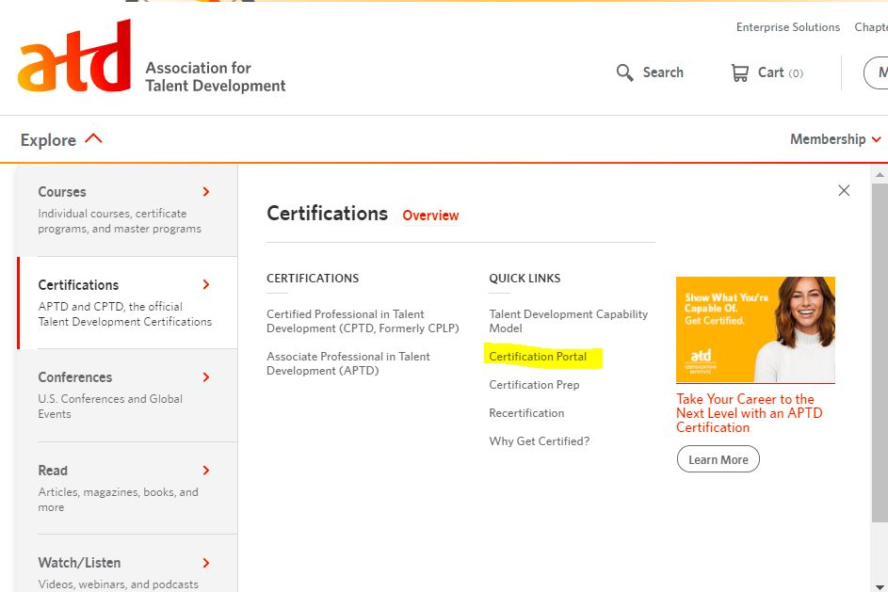
Certification Portal
Notes:
So, where do you find this portal?
One of the easiest places is on the td.org landing page – if you click on the Explore drop down menu, select Certification and you’ll see the certification portal over on the right.
Other places to go:
www.td.org/certification/recertification-program this page has the policies, job aid for using the portal, a link to the portal and more.
Give them the long link?

Slide 26
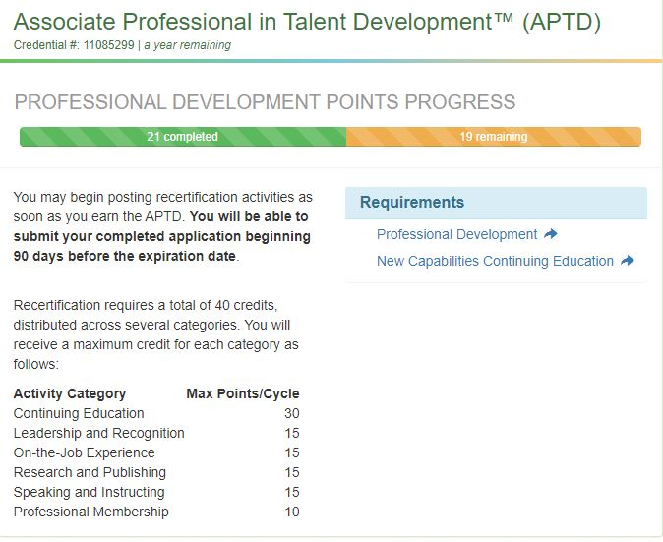
Portal for Recertification
To enter professional development activities
Progress bar
Notes:
We’re very excited about the new portal because it makes recertification so much easier for everyone. When you login to the certification portal, you will see a landing page that looks like this page.
You can enter continuing education and other activities at any time
It will show you your progress towards recertification – number of points remaining
The platform will also do the math for you and will not accept points above the maximums or below the minimums
You will be able to easily find your recertification dates
No more paper or emailed applications
Automated reminders
From this page, you can click on either of the links under requirements or on the left hand side where it says manage activities.
https://www.td.org/certification/recertification-program

Slide 27
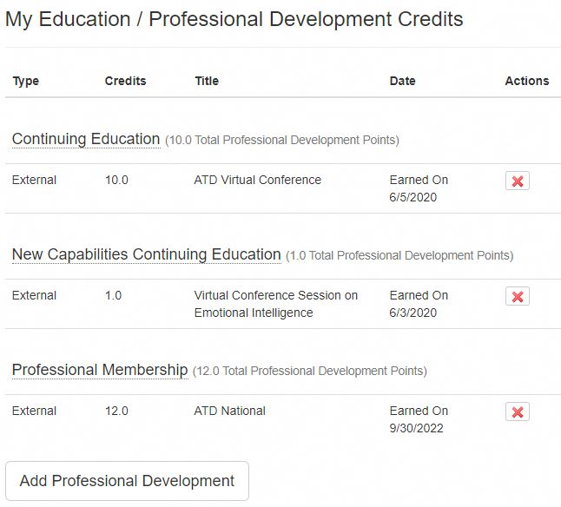
Add Professional Development
To add an entry
Notes:
Clicking on that will take you to your professional development entries. To add more entries, just click on Add Professional Development at the bottom of the screen.

Slide 28
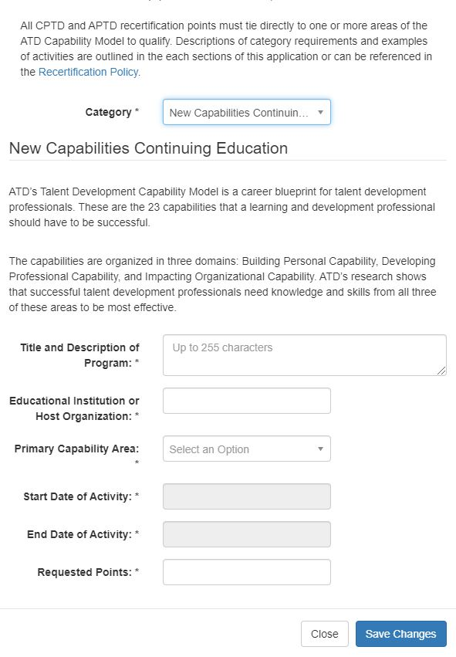
Select a Category
Choose category
Enter capability area*
Enter information
Notes:
When you click on add professional development, you will need to select a category, such as new capabilities, leadership & recognition and so forth.
Once you select a category, the rules for that category will appear on the screen along with the fields you need to complete. Generally, you will need the dates you completed the activity, the number of points you are requesting, the title and organization that provided the program, etc.
Once you have entered enough points, click on the Home button on the left hand side of the screen.

Slide 29
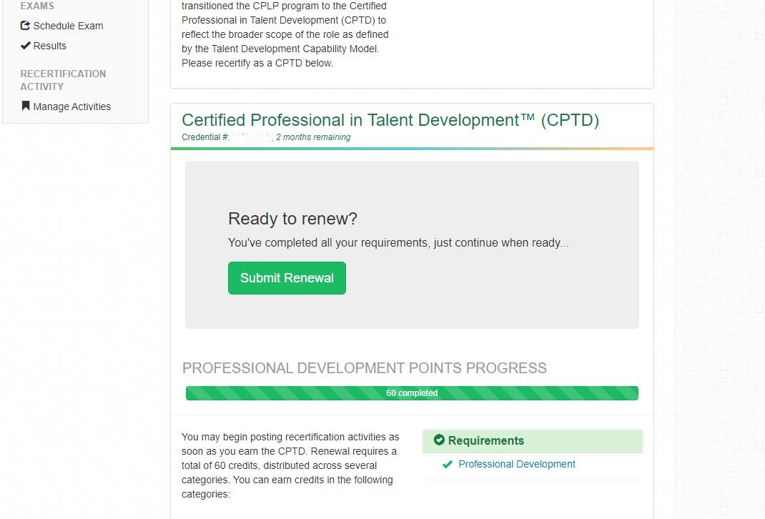
Ready to Renew?
Notes:
That will take you back to your certification portal landing page. If your progress bar has turned green, you should also see a button that says Ready to Renew? At that point, you submit your renewal and will be asked some demographic questions. Once you click Pay you will be taken to the td.org payment portal to complete your transaction.

Slide 30
Common Problems
Duplicate records
Incorrect email address
Javascript
New capabilities must be added
Cannot pay until 90 days before expiration date
Editing entries
Notes:
These are some of the common problems that people run into:
When you try logging in to the certification portal you just see the normal td.org landing page – you do not get the certification portal. THIS USUALLY MEANS THAT YOU HAVE A DUPLICATE RECORD on td.org and the system can’t find your certification record. If you have this problem, email me at recertification@td.org and we’ll get your record straightened out.
Your email address on file with td.org has changed, but you haven’t logged into the certification portal, so we have your old email address. PLEASE try logging into the certification portal NOW to make sure we have your correct email address. All reminder notices go to the email address on record with the certification institute.
You login to the certification portal, but there isn’t a progress bar – the screen doesn’t look like the one I showed you. Make sure that Javascript is enabled in the browser you’re using. Chrome usually works well – we seem to have the most problems with Internet Explorer.

Slide 31
Resources
Notes:
So, what resources exist to help you with your recertification?

Slide 32
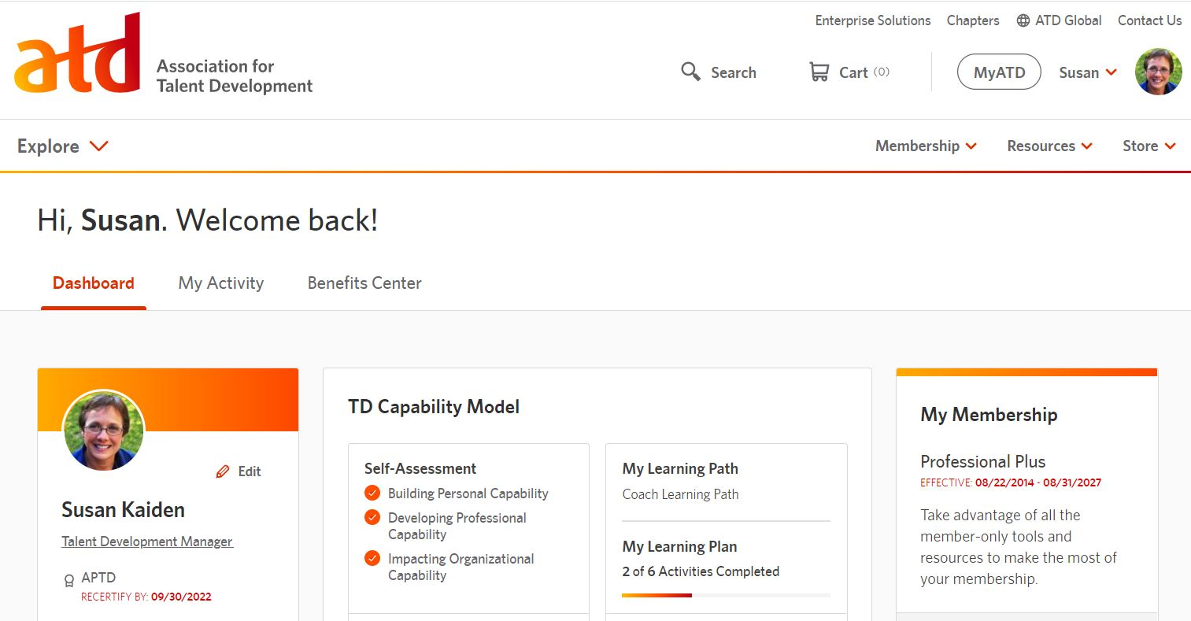
MyATD Dashboard
https://my.td.org/myatd/dashboard
Notes:
The other helpful new feature on the website is the MyATD dashboard area. If you login to td.org and click MyATD, you’ll see information about your certification, your membership status and much more.

Slide 33
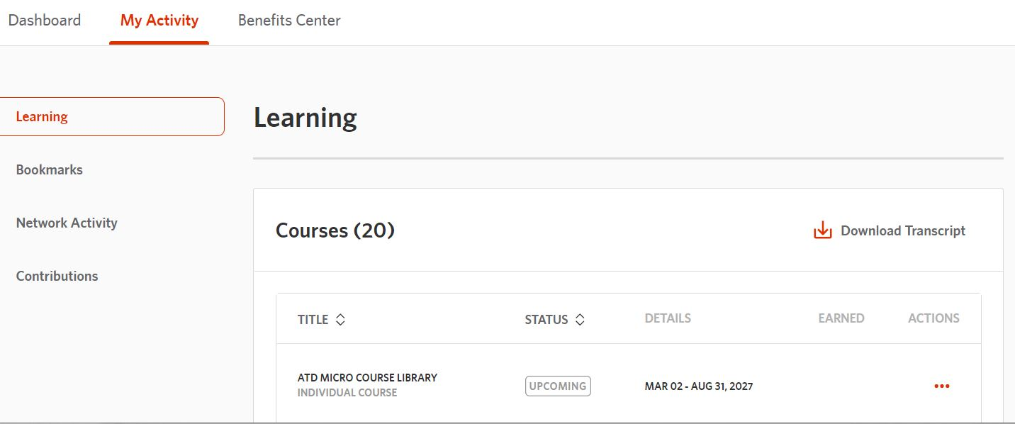
My Learning History
https://my.td.org/myatd/activity-history/learning
Notes:
If you click on My Activity, you’ll see your ATD courses and transcript and if you scroll down, you’ll see your conferences and webinars that you’ve attended or registered for.
A lot of very helpful information in the MyATD dashboard.

Slide 34
Resources
Recertification Policies
  Recertification Portal Job Aid
  Free & Inexpensive Recertification
  Listing of micro-course library modules
Link to certification portal
LinkedIn Group
Facebook Group
Preapproved Education Providers
Interactive Capability Model
My ATD – My Activities
Notes:
On the recertification program page, you can find the policies, portal job aid, a list of free and inexpensive recertification activities and so forth.
The links to all of these items will be in the pdf that you’ll get a link for tomorrow.
Book mark this page because it has job aids and other useful information
www.td.org/certification/recertification-program

Slide 35
Questions?
General Questions
certification@td.org
Recertification Questions
recertification@td.org

