Slide 1



DEI STRATEGIC PLANNING WORKBOOK
7 Strategies to Improve Diversity, Equity & Inclusion as a Business Driver

Slide 2

How to use this workbook
In this deck, we have compiled the most effective components for presenting the case for Diversity, Equity, and Inclusion (DEI) learning. This deck will be even more effective if tailored to your organization, so please feel free to edit the deck as necessary.
You know your leaders/employees and what will resonate with them, feel free to mix and match the following slides to what will be the most impactful for you.
From having worked with thousands of companies and millions of users to implement DEI initiatives, we know that storytelling works. We’ve added space along the way for you to add your own personal experiences.
Notes:
We know talking about Diversity, Equity, and Inclusion, and being the champion of the initiative is hard. We put this workbook in a deck to help you educate others on the importance of DEI in hopes of co-creating a strategy. The purpose of this deck depends on where your organization is in the DEI journey. If you’re just starting out, you may need to spend more time talking about the business case. If you’re farther along, you may want to spend more time discussing why you think giving employees access to e-learning courses is the next best step. We recommend setting aside 60 minutes at a minimum, but you’ll likely need more time if you have an engaged group or plan on sharing a long story of why DEI is important to you and the organization.

Slide 3
Diversity, Equity & Inclusion (DEI)
at [YOUR COMPANY NAME]
Insert your Company
Logo Here
Introduction
Laying The Foundation
Our 7 Strategies
Takeaways and Q&A
YOUR NAME
YOUR JOB TITLE
YOUR DEPARTMENT / DIVISION
COMPANY NAME

Slide 4





Most comprehensive catalog (>20,000 courses) from the world’s leading publishers. Multiple languages, formats, mobile friendly, all in one place.
Developing the world’s most productive and admired workforces
Quality matters. Courses are reviewed using quality standards for suitability and compatibility. User ratings for courses are easy to find.
Seamless integration with any LMS. Easily find, purchase, administer, sync courses with your learning and other HR systems.
Expert curation and easy courses updates. We curate so you don’t have to. New or updated courses are easy to sync with your library.

Slide 5









Business Skills
Leadership / Management
Accounting
Telephone Skills
Time Management
Sales
Communication
Technology
Microsoft Office
Desktop
Social Media
IT
Cisco
Web Development
Safety
Workplace Safety
OSHA
Fire Safety
Forklift Safety
Defensive Driving
Certifications
Microsoft Certification
Project Management
(PMI / PMBOK)
Human Resources
CompTIA
Most comprehensive catalog from world’s top publishers
Compliance
Ethics
GDPR
Privacy
Cybersecurity
Code of Conduct
Bribery & Corruption
Harassment Prevention
Industry Specific
Finance
Healthcare
Hospitality
Banking
Manufacturing
Oil & Gas
Foreign Languages
Diversity, Equity & Inclusion
Unconscious Bias
Inclusive Leadership
Mental Health Awareness
Building Diverse Teams
Generational Diversity
Intercultural Competence
Wellness
Corporate Wellness
Stress Management
Mindfulness and Meditation
Exercise and Fitness
Resilience
Work/Life Management

Slide 6
What DEI challenges are we facing?
Who is our workforce?
What is most important to them?
What are our organization's DEI goals & objectives?
How does elearning fit into our DEI and L&D strategy?
How can our organization use L&D to adapt to market changes?
Notes:
In order for the conversation to progress, leadership MUST be bought in. Frankly, as leaders, they should already know the importance of diversity and inclusion as the research is overwhelming.
Start a discussion where you ask leadership to answer some or all of these questions.

Slide 7
A Business Case:
The importance of Diversity, Equity, and Inclusion
Inclusive leadership improves team performance by 17%, decision making quality by 20%, and team collaboration by 29%
Companies in the top quartile for racial and ethnic diversity are 35% more likely to have financial returns above their respective national industry medians
The relationship between Diversity and Innovation is positive and statistically significant
Notes:
This slide is to provide an additional research based gut-check and level set so you can discuss how you plan on building a diversity, equity, and inclusion strategy. We’ve called out team performance, financial performance and innovation because these outcomes are importance across industries, but feel free to add your favorite research here if you think something else will resonate.
Deloitte: https://www2.deloitte.com/us/en/insights/deloitte-review/issue-22/diversity-and-inclusion-at-work-eight-powerful-truths.html
McKinsey: https://www.mckinsey.com/business-functions/organization/our-insights/why-diversity-matters
BCG: https://www.bcg.com/en-us/publications/2017/people-organization-leadership-talent-innovation-through-diversity-mix-that-matters.aspx

Slide 8

Our Future of Work is Intersectional
The workforce is increasingly more diverse.
more women
more people of color
more than 2x the people in Gen Z identify as LGBTQ+ than in Gen X
Notes:
This slide demonstrates further that our future is going to look dramatically different than how it does today. We need people in the room to understand that macroeconomic and socio-cultural changes are going to shift the way we do business. It’s up to leaders to adapt - or risk falling behind.
The future world does not look like the world we live in today. The future is intersectional - for every 100 Straight White Men exiting the workforce (55 years old+), only 66 SWM men are filling their shoes (looking at the <25 group).
So what does the Gen Z workforce look like then? The entering workforce is increasingly more diverse, more women, more people of color, and more than 2x identify as LGBTQ. This will influence the way you operate as a company (because your customers are going to be more diverse than before). It’s also going to dramatically change how you hire and build an inclusive culture. The opportunity is ours; companies that “get it” are going to build businesses and brands that last. Companies that don’t understand the future and the implications of this data will not survive. They won’t be able to hire and retain employees - and won’t be able to market and sell to the increasingly diverse customer base.
It can be easy to get stuck in a general conversation about Diversity, Equity, and Inclusion. While understanding the external reasons to focus on DEI is important, we recommend moving to the personalized reasons (why it’s important for your company, right now), as soon as it seems people understand the external reasons.

Slide 9
Why it’s important to [Your Company Name]
[Add a quote, statistic, or statement about why Diversity and Inclusion is important at your company]
Notes:
Considering who will be in the room and how you’ve seen them be influenced, we suggest you input a quote, statistic, or story that connects diversity, equity, and inclusion to an issue that is personally important to those in the room.
Suggestions:
●Quote from CEO/Leadership team
●Reflection on diverse customer base (or how internal DEI can expand your customer base)
●Data/statistic about inclusion in your industry or field
●Data/statistic about how inclusion is valued by employees
●Reflection on how DEI connects to your company values
●Story - either your own or a fellow coworker’s

Slide 10
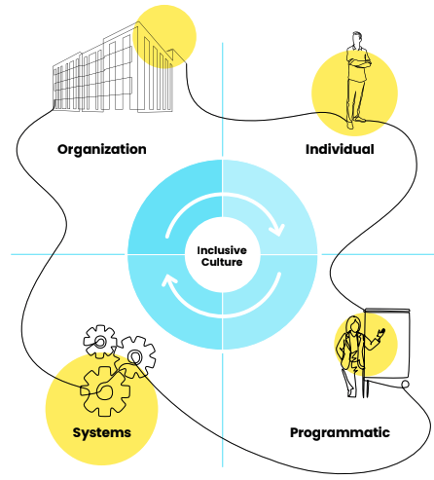
The Seven DEI Strategies for Success
Take a Holistic Approach
Establish and Demonstrate Strong Values
Prioritize DEI Efforts Based on Business Needs
Develop Continuous Learning Experiences
Measure, Evaluate, and Evolve
Leverage Technology
Celebrate Progress and Success
Notes:
The Seven Strategies for Diversity, Equity, and Inclusion (DEI) Success: https://www.opensesame.com/lists/detail/1133133

Slide 11

Strategy 1:
Take a Holistic Approach
The Seven DEI Strategies for Success

Slide 12

#1: Take a Holistic Approach
DEI Touchpoints to identify:
Internal Communications
Messages
Workshops
Intranet
Customer Support and Relationship Management
CRM System, Policies and Privacy
Web
Email
Call Center
Advertising
Agencies and Partnerships
  Television
  Radio
  Print
  Website
  Web Banners
  Sponsorships
Human Resources
Promotion and Career Growth
Diversity and Hiring Practices
Compensation and Benefits
Product Design
Research and Development
Product Engineering
Quality Control
Manufacturing
  Product Aesthetics
  Product Usability
  Product Usefulness
Public Relations and Media Relations
Agencies and Partnerships
  Press Releases
Facilities
Physical Work Environment
Virtual Work Environment
IT
User Support
Shareholder Relations
Governance and Transparency
Events
Annual Reports
Financial Reporting Policies
Shareholder Newsletter
Operations
Structure and Controls
Sales and Product Marketing
Direct Marketing
Product Marketing
In-store Marketing
Corporate Social Responsibility
Philanthropy and Community Programs
  Environmental Policy
  Education Policy
  Globalization Policy
  Media Coverage
  Annual Reports
Supplier Management
Supply Chain Management
  Suppliers
Notes:
The Seven Strategies for Diversity, Equity, and Inclusion (DEI) Success: https://www.opensesame.com/lists/detail/1133133

Slide 13
#1: Take a Holistic Approach
DEI Strategy Project Team
Name | Title | RACI | Activities
What does RACI stand for?
Responsible
Who is responsible for doing the actual work for the project task.
Accountable
Who is accountable for the success of the task and is the decision-maker. Typically the project manager.*
Consulted
Who needs to be consulted for details and additional info on requirements. Typically the person (or team) to be consulted will be the subject matter expert.
Informed
Who needs to be kept informed of major updates. Typically senior leadership.
Notes:
The Seven Strategies for Diversity, Equity, and Inclusion (DEI) Success: https://www.opensesame.com/lists/detail/1133133

Slide 14
Strategy 2:
Establish and Demonstrate Strong Values
The Seven DEI Strategies for Success
Notes:
The Seven Strategies for Diversity, Equity, and Inclusion (DEI) Success: https://www.opensesame.com/lists/detail/1133133

Slide 15

#2: Establish and Demonstrate Strong Values
Brainstorm your purpose
Use the prompts below to brainstorm your purpose for DEI
What does a diverse workforce look like?
What does an inclusive culture look like?
What is the purpose of measuring DEI?
What sparked an interest in improving DEI?
Who will be informed of the purpose?
What are the outcomes you hope to achieve?
What does success look like?
Notes:
The Seven Strategies for Diversity, Equity, and Inclusion (DEI) Success: https://www.opensesame.com/lists/detail/1133133

Slide 16
1/2
#2: Establish and Demonstrate Strong Values
Group Your Values Worksheet
From the list below, circle the values that resonate with you. Do not over think your selections.
If you think of a value that is not on this list, be sure to write it down as well.
Abundance
Daring
Intuition
Acceptance
Decisiveness
Joy
Proactivity
Achievement
Dedication
Kindness
Professionalism
Advancement
Dependability
Knowledge
Punctuality
Adventure
Diversity
Leadership
Advocacy
Empathy
Learning
Relationships
Ambition
Encouragement
Love
Reliability
Appreciation
Enthusiasm
Loyalty
Usefulness
Collaboration
Health
Professionalism
Thankfulness
Cheerfulness
Recognition
Traditionalism
Spirituality
Versatility
Consistency
Honesty
Stability
Vision
Resilience
Attractiveness
Ethics
Making a Difference
Resourcefulness
Autonomy
Excellence
Teamwork
Mindfulness
Responsibility
Balance
Expressiveness
Motivation
Preparedness
Responsiveness
Being the Best
Ethics
Optimism
Security
Benevolence
Open-Mindedness
Self-Control
Boldness
Originality
Selflessness
Brilliance
Fairness
Passion
Contribution
Humility
Peace
Warmth
Creativity
Humor
Perfection
Wealth
Credibility
Inclusiveness
Fun
Quality
Thoughtfulness
Community
Simplicity
Calmness
Family
Performance
Stability
Caring
Friendships
Personal
Development
Success
Challenge
Flexibility
Proactive
Charity
Freedom
Cleverness
Generosity
Trustworthiness
Commitment
Growth
Safety
Understanding
Compassion
Flexibility
Security
Uniqueness
Cooperation
Happiness
Service
Grace
Playfulness
Well-Being
Curiosity
Independence
Popularity
Wisdom
Accountability
Individuality
Power
Zeal
Innovation
Inspiration
Intelligence
Flexibility
Security
Uniqueness
Cooperation
Notes:
The Seven Strategies for Diversity, Equity, and Inclusion (DEI) Success: https://www.opensesame.com/lists/detail/1133133

Slide 17
2/2
#2: Establish and Demonstrate Strong Values
Group Your Values Worksheet
Group all similar values together from the list of values you just circled.
Select the Top 3-6 Values
Notes:
The Seven Strategies for Diversity, Equity, and Inclusion (DEI) Success: https://www.opensesame.com/lists/detail/1133133

Slide 18
#2: Establish and Demonstrate Strong Values
Define DEI, or DEIB, or DEIAB
DIVERSITY
The representation of various identities and differences
EQUITY
Ensuring that every individual has an equal opportunity to make the most of their lives and talents.
INCLUSION
Authentically bringing traditionally excluded individuals and/or groups into processes, activities, and decision/policy making in a way that shares power.
Notes:
The Seven Strategies for Diversity, Equity, and Inclusion (DEI) Success: https://www.opensesame.com/lists/detail/1133133

Slide 19
#2: Establish and Demonstrate Strong Values
Definitions of DEI at your Organization
Please review your organization’s current definition of diversity, equity, and inclusion. Ask yourself the following:
Are there elements that are missing? Are there areas that need attention?
Is this definition well understood? Is this definition ingrained in the culture of the organization?
D (Diversity) | E (Equity) | I (Inclusion)
Your goals for DEI reflect the desired outcomes of the strategic plan. To achieve them, they must align with the institution’s stated vision, mission, and values and be seen by all as strategic initiatives so they are not “siloed.”
Notes:
The Seven Strategies for Diversity, Equity, and Inclusion (DEI) Success: https://www.opensesame.com/lists/detail/1133133

Slide 20
Strategy 3:
Prioritize DEI Efforts Based on Business Needs
The Seven DEI Strategies for Success
Notes:
The Seven Strategies for Diversity, Equity, and Inclusion (DEI) Success: https://www.opensesame.com/lists/detail/1133133

Slide 21

#3: Prioritize DEI Efforts Based on Business Needs
Strategic Goals & Priorities
Based on the data you analyzed in #1, what DEI goals should your organization focus on?
Organizational Strategic Goal | DEI Implications | Core Value
Department Strategic Goal | DEI Implications | Core Value
Team Strategic Goal | DEI Implications | Core Value
Individual Strategic Goal | DEI Implications | Core Value
Notes:
The Seven Strategies for Diversity, Equity, and Inclusion (DEI) Success: https://www.opensesame.com/lists/detail/1133133

Slide 22
Strategy 4:
Develop Continuous Learning Experiences
The Seven DEI Strategies for Success
Notes:
The Seven Strategies for Diversity, Equity, and Inclusion (DEI) Success: https://www.opensesame.com/lists/detail/1133133

Slide 23

#4: Develop Continuous Learning Experiences
Goal to achieve (Based on #3 step)
Gaps in Knowledge
Take the DEI Survey
What do people need to know based on the results of their DEI Survey?
Timeline
Develop a Cycle of Inquiry
Notes:
The Seven Strategies for Diversity, Equity, and Inclusion (DEI) Success: https://www.opensesame.com/lists/detail/1133133

Slide 24
Strategy 5:
Measure, Evaluate, and Evolve
The Seven DEI Strategies for Success
Notes:
The Seven Strategies for Diversity, Equity, and Inclusion (DEI) Success: https://www.opensesame.com/lists/detail/1133133

Slide 25

#5 Measure, Evaluate and Evolve
Collect Organizational Demographic Data
Goal to achieve (Based on #3 step)
Workforce Composition
Engagement Data
New Hire Data
Exit Data
Current DEI Training Programs
Notes:
The Seven Strategies for Diversity, Equity, and Inclusion (DEI) Success: https://www.opensesame.com/lists/detail/1133133

Slide 26
#5 Measure, Evaluate and Evolve
Examples of What to Measure
DIVERSITY MEASURES
Representation: Percentage of employees from monitored groups compared with company and industry benchmarks.
Retention: Comparing average tenure for employees from monitored groups to average tenure across the workforce or average tenure of members of the dominant group.
Recruitment: Comparing the number of applicants for open positions from monitored groups against the potential pool of applicants from monitored groups or labour market representation.
Selection: Tracking appointments of individuals from monitored groups compared with appointments of applicants who are not members of a monitored group. Useful for identifying bias in assessment and selection.
Promotion: Tracking promotions awarded to individuals from monitored groups compared with promotions awarded to individuals who are not members of a monitored group. Useful for identifying bias in assessment and selection.
Development: Tracking lateral moves, appointments to acting roles, training and other learning and development participation, and other stretch assignment opportunities by identity group. Useful for identifying bias in development.
Pay and benefits: Compare financial and non-financial rewards earned by individuals from monitored groups to financial and non-financial rewards earned by individuals who are not members of a monitored group. Useful for identifying bias in compensation and reward schemes.
Notes:
The Seven Strategies for Diversity, Equity, and Inclusion (DEI) Success: https://www.opensesame.com/lists/detail/1133133

Slide 27
#5 Measure, Evaluate and Evolve
Examples of What to Measure
INCLUSION & BELONGING MEASURES
Inclusion and Belonging
  I am proud to work here
  I would recommend this company as a great place to work
  This company motivates me to go beyond what I would in a similar role elsewhere
  I rarely think about looking for a job at another company
  I see myself still working at this company in two years' time
Fairness
  Administrative tasks that don't have a specific owner (e.g., taking notes in meetings, scheduling events, cleaning up shared space) are fairly divided at Self
  My job performance is evaluated fairly
  I believe that my total compensation is fair, relative to similar roles at Self
Opportunities and Resources
  When there are career opportunities at Self, I am aware of them
  I know where to find information to do my job well
  Self believes that people can always greatly improve their talents and abilities
  Self enables me to balance work and personal life
Decision Making
  I am satisfied with how decisions are made at Self
  Perspectives like mine are included in the decision making at Self
  I am included in decisions that affect my work
More at www.cultureamp.com
Notes:
The Seven Strategies for Diversity, Equity, and Inclusion (DEI) Success: https://www.opensesame.com/lists/detail/1133133

Slide 28
#5 Measure, Evaluate and Evolve
DEI Focus Group Sessions Worksheet
Have you ever felt left out at the organization – either in work practices or socially?
What makes you feel like you belong at the organization?
In your experience, what are some barriers people don’t see but impact your ability to participate in the organization?
Do you have any experiences of masking or downplaying aspects of yourself at work?
In your experience, what are some ways the organization can be more inclusive?
How can your peers, managers, leaders, and other partners at the organization be more inclusive?
If you’re comfortable with sharing, have you ever felt emotionally or physically unsafe?
Notes:
The Seven Strategies for Diversity, Equity, and Inclusion (DEI) Success: https://www.opensesame.com/lists/detail/1133133

Slide 29
#5 Measure, Evaluate and Evolve
External Data to Collect
MARKETPLACE & COMMUNITY IMPACT
How does the current political climate impact employees from marginalized groups?
Are there any government policies that affect minority employees? (e.g. childcare/healthcare policies, labor regulations/immigration)
What is the political narrative and discourse on DEI?
What are competitors doing in DEI?
What emerging economic disruptions will impact DEI at your organization?
Is your workforce representative of the target customer base/industry the organization operates in?
How diverse is your vendor pool/industry? Does the organization source from diverse vendors?
What are the labor force participation rates of diverse groups?
What percentage of the unemployment rate is minority groups?
What are the immigration rates?
What are the urban population growth trends?
What are the demographics of the communities the organization operates in?
What social inequalities/barriers exist for minority employees?
What is being said on social media about your organization’s DEI state?
What social movements are currently taking place? (e.g. Black Lives Matter, MeToo)
What human rights legislations are in place in relation to DEI?
What are the minimum requirements established by the government for DEI at workplaces?
Are there any labor laws that impact DEI at the organization?
Notes:
The Seven Strategies for Diversity, Equity, and Inclusion (DEI) Success: https://www.opensesame.com/lists/detail/1133133

Slide 30
#5 Measure, Evaluate and Evolve
Performance Dashboard
STRATEGIC GOAL | STATUS | TASK MILESTONE | LEAD | PROPOSED NEXT STEPS
List strategic goals below | Identify the status | List tasks and their accompanying metrics from Essential Tasks 4-6 below | Task owner | Propose appropriate next steps for leadership to discuss and approve
Strategic Goal 1
 | ON TRACK
 | NEEDS ATTENTION
 | OFF TRACK
Strategic Goal 2
Notes:
The Seven Strategies for Diversity, Equity, and Inclusion (DEI) Success: https://www.opensesame.com/lists/detail/1133133

Slide 31
Strategy 6:
Leverage
Technology
The Seven DEI Strategies for Success
Notes:
The Seven Strategies for Diversity, Equity, and Inclusion (DEI) Success: https://www.opensesame.com/lists/detail/1133133

Slide 32

#6: Leverage Technology
Performance Dashboard
What technology tools are available/being used to provide DEI analytics?
1
Is there a disruptive technological change that would require diverse talent?
2
What impacts have artificial intelligence and workforce automation had on diverse individuals/employee groups in the industry?
3
Notes:
The Seven Strategies for Diversity, Equity, and Inclusion (DEI) Success: https://www.opensesame.com/lists/detail/1133133

Slide 33
#6: Leverage Technology
Performance Dashboard
Employee Lifecycle Stage | People Identify people who are a part of the employee lifecycle | Process Evaluate existing processes to identify systemic changes needed to improve DEI | Technology Assess the technology or other resources used in each stage of the life cycle for inequities such as poor accessibility or biases
Attract | How are we attracting people of diverse backgrounds (e.g. people with disabilities, veterans, people of color)? | Are we reaching out to a variety of post-secondary institutions (e.g. technical schools, state schools, historically Black colleges or universities)? | Are we using accessible platforms for reaching out to candidates (e.g. leveraging community partnerships)?
Recruit | Are there any groups of people who are not being screened (e.g. people of color, women)? | Are we interviewing/hiring enough candidates from diverse backgrounds? | Are we using technology that may be screening employees out of the process based on superficial/subjective characteristics?
Onboard | Who are new hires meeting when they’re hired? Do new hires from diverse backgrounds feel a sense of belonging? | Are we introducing new hires fairly to important stakeholders (e.g. forman networking for new hires, mentorship programs)? | Is the technology we’re using for onboarding accessible? Have we designed the onboarding experience based on multiple, diverse groups of users?
Perform | Are diverse groups of employees given equal opportunities to projects and assignments? | Are performance reviews as objective as possible? | Are talent assessments objective and fair?
Grow | Are diverse groups of employees growing in the organization or is there a glass ceiling impacting specific groups of employees? | Are diverse groups of employees being promoted? | Have LMS modules been assessed to be accessible (e.g. audio/visual impairments)?
Exit | Are there specific groups of employees experiencing higher turnover? | How are we treating groups of employees when they are off-boarded?
Alumni | Which groups of alumni are we engaging with (e.g. only male alumni)?
Notes:
The Seven Strategies for Diversity, Equity, and Inclusion (DEI) Success: https://www.opensesame.com/lists/detail/1133133

Slide 34
Strategy 7:
Celebrate Progress
and Success
The Seven DEI Strategies for Success
Notes:
Remove circles

Slide 35

🎉
#7: Celebrate Progress and Success
Organizational Strategic Goal | DEI Implications | Core Value | Celebration
Department Strategic Goal | DEI Implications | Core Value | Celebration
Team Strategic Goal | DEI Implications | Core Value | Celebration
Individual Strategic Goal | DEI Implications | Core Value | Celebration
Notes:
The Seven Strategies for Diversity, Equity, and Inclusion (DEI) Success: https://www.opensesame.com/lists/detail/1133133

Slide 36
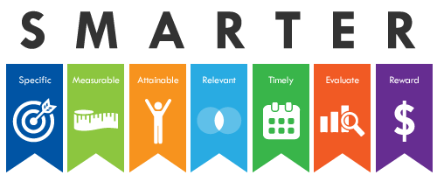
🎉
#7: Celebrate Progress and Success
Notes:
The Seven Strategies for Diversity, Equity, and Inclusion (DEI) Success: https://www.opensesame.com/lists/detail/1133133

Slide 37
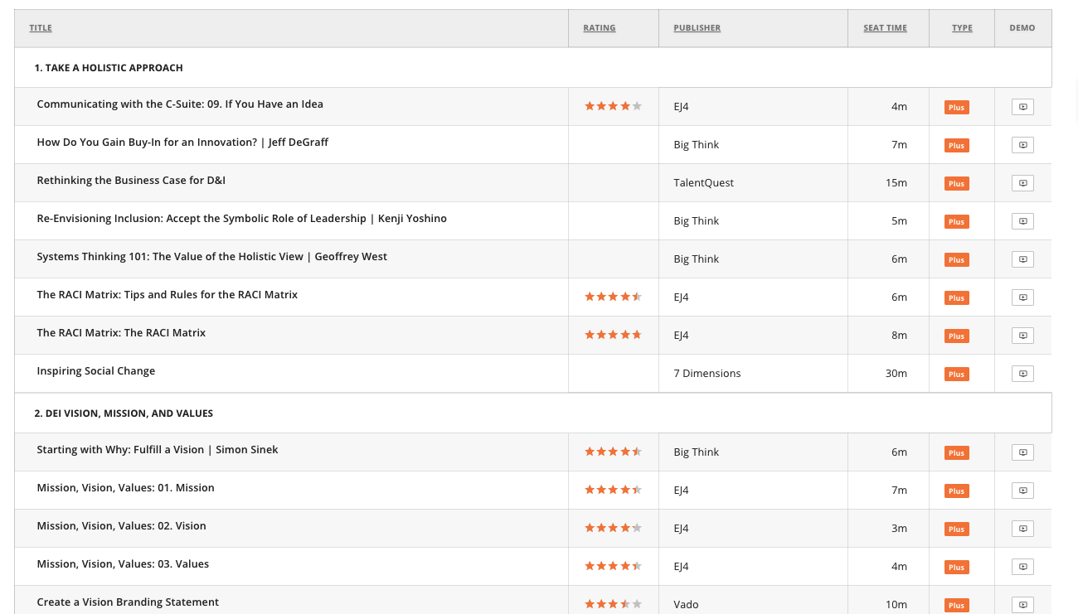
The Seven Strategies for Diversity, Equity, and Inclusion (DEI) Success Courses
Notes:
The Seven Strategies for Diversity, Equity, and Inclusion (DEI) Success: https://www.opensesame.com/lists/detail/1133133

Slide 38
The Seven DEI Strategies for Success
Take a Holistic Approach
Establish and Demonstrate Strong Values
Prioritize DEI Efforts Based on Business Needs
Develop Continuous Learning Experiences
Measure, Evaluate, and Evolve
Leverage Technology
Celebrate Progress and Success
Notes:
The Seven Strategies for Diversity, Equity, and Inclusion (DEI) Success: https://www.opensesame.com/lists/detail/1133133

Slide 39

Notes:
Register Here: https://go.opensesame.com/learning-unlocked

Slide 40





Start your organization’s DEI journey now.
Watch the Webinars
Read the Whitepapers
Take the Survey
Explore the Toolkit
www.opensesame.com | (503) 808-1286 | info@opensesame.com
Notes:
Sources for Attribution
https://hr.mcleanco.com/research/diversity-equity-and-inclusion-workbook
https://dei.extension.org/extension-resource/equity-assessment-worksheet
https://www.aamc.org/services/member-capacity-building/diversity-and-inclusion-strategic-planning-toolkit
https://diversity.berkeley.edu/sites/default/files/admin_strategic_planning_toolkit_final.pdf
https://centreforglobalinclusion.org
https://positivepsychology.com/wp-content/uploads/Core-Values-Worksheet.pdf
https://www.cultureamp.com/diversity-inclusion-starter-kit
The Seven Strategies for Diversity, Equity, and Inclusion (DEI) Success: https://www.opensesame.com/lists/detail/1133133

