Slide 1


Slide 2

What You Need to Know about Using AI on Your Global Trainings

Slide 3

        Presenter
        Sergio is the managing director at Idea Translations and one of its founding partners. He has been in the translation industry for over 18 years and has focused primarily on the translation of eLearning content for the last 9. He is a regular ATD presenter and has helped organizations such as L’Oréal, Panera Bread, the Inter-American Development Bank, Merck, American Airlines, WOBI, Wisconsin’s Office of
        Public Instruction and others, with their global deployment of eLearning content.
Idea Translations is an ISO 9001, ISO 27000 and
ISO 17100 certified company in the production of translation, design and eLearning projects and it is also a certified B Company.

Slide 4
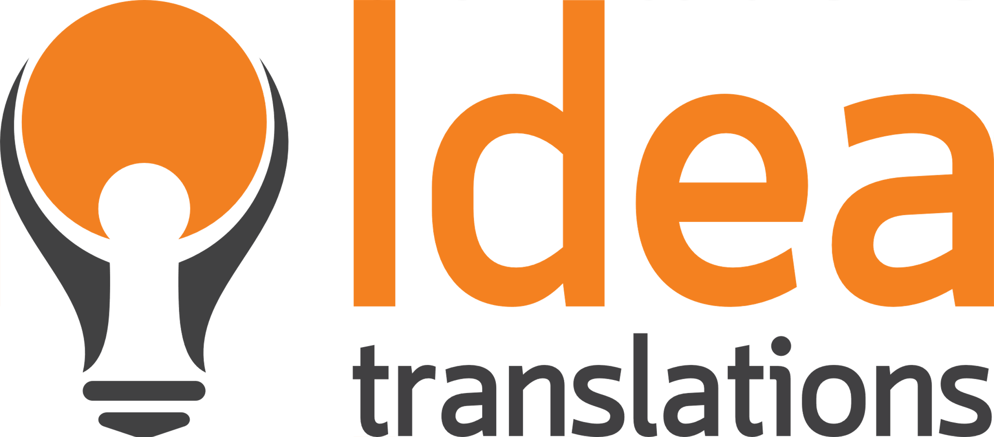

Key Takeaways
How and when to use AI to get your trainings global-ready
What specific services have AI options
What types of content yield better results when using AI
Why languages and data matter
How to create a strategy to implement AI
in global trainings
Notes:
Thanks again for joining us on this new webinar. I am Sergio Atristain . I am the managing director of Idea Translations and I have been in the translation business for about 18 years. We are regular exhibitors and presenters at the ATD and focus in helping organizations build talent without worrying about language.
This webinar will focus on information we have gathered on the myriad of questions that came about the AI hype and how have some tools emerged to help accelerate and potentially reduce costs when translating training content including videos and eLearning courses. So what will you take home from this webinar:
How and when is AI an option for your trainings from a translation and globalization point of view. In other words, You have your training ready and now you need to make it global ready. What to consider to decide whether or not using a 100% AI approach, a hybrid or a full human process.
All training have several assets, text, videos, narration, interactions. There are plenty of AI tools available to use but are they all suitable to use in our assets?
All content is not created equal. Some content yields better outputs than other when using AI. How can we evaluate the quality of the output based on the original content.
Some languages have large sets of data, some don’t. This affects output quality for AI generated content.
AI is a great productivity leap in the age of information. But as with most great advancements, they require human instructions, processing and guidance. So we will discuss how to create a strategy that meets your goals using AI

Slide 5




The Impossible Request Triangle
Rank them by importance
Two will be possible
One will be compromised
Notes:
I imagine most of you have seen something similar to this triangle. At Idea Translations we call it the impossible request triangle. Time is on one angle, money is in another and quality is on third one. And it’s very important when managing a multilingual or global learning project because we need to understand the priorities in order to select the best possible process. Therefore before starting with your project there are a few very general questions that will help us select the right path.
Do we have a set deadline or not?
Is there a set budget?
Who is our target audience? What do we need to accomplish with this project?
The reason why these questions are important, even if the responses are a bit vague like, beginning or end of Q3 for the deadline or the same budget as the last project, is because we need to rank time, budget and quality in terms of importance. In other words 2 can be guaranteed but not all three .
When I mention the need for placing value in these variables the most common response is “Quality is Always the most important”. However, quality is a highly subjective term and it means different things to each one of us.

Slide 6
Quality can be defined as
conformance to specifications.
The degree to which a product meets the design specifications offering a satisfaction factor
that fulfils all the expectations
that a customer wants.
conformance to specifications.
that fulfils all the expectations that a customer wants.
Notes:
Here is the definition of quality: Conformance to specifications. The degree to which a product meets the design specifications offering a satisfaction factor that fulfils all the expectations that a customer wants.
Conformance to specifications and Fulfils the expectations that a customer wants. In this sense, quality for a customer can be prompt and quick service.
In a car wash for example, you have the customer that wants to get in and get out quickly. That is great quality for them. Very different from the client that wants the car polished, detailed and absolutely spotless. That is quality to them. They are aware they will have to wait more, because that attention to detail requires more work and of course more money. They know they’ll have to pay more.

Slide 7
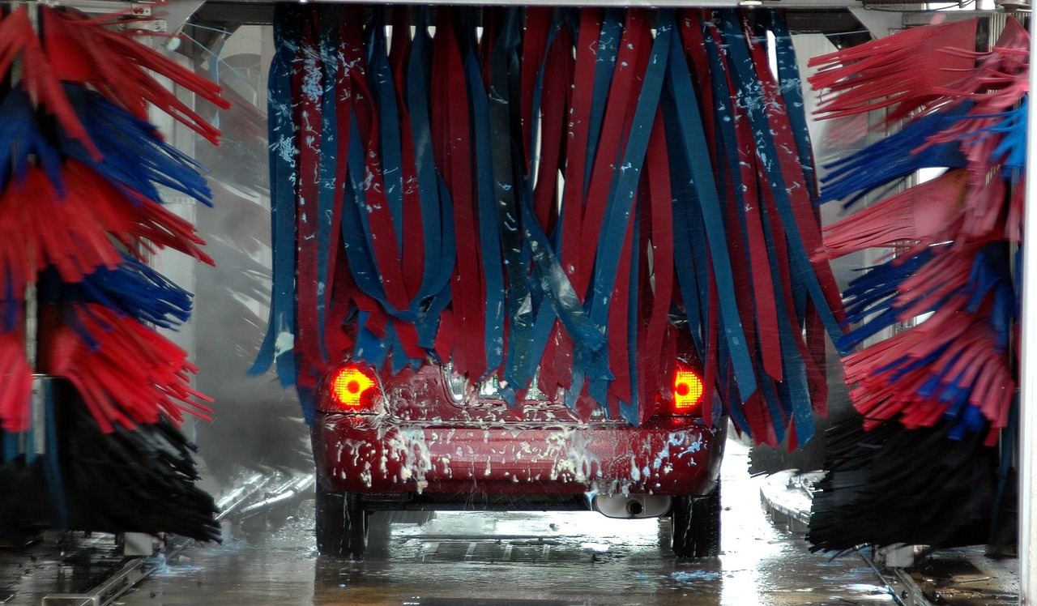




The Impossible Triangle
in a Car Wash
Notes:
To picture this let’s say the customer just wants quick and cheap. A quick pass by the autocar wash will likely do.
If the customer wants great quality but has a very limited budget. Maybe they decide to wash the car themselves in a manual car wash or contact that teenage neighbor to wash their car. That might not guarantee quality but you can always point at the details requiring work and they’ll do it…they want to get paid after all. Or the customer values time and they want their car spotless…they need to take it to a pro car wash. They know it will cost them a lot more than the auto car wash or the car washing neighbor.
So the question here is what kind of a car wash do you want? What are the stakes?
The example of the car wash assumes that anyone can wash a car…which clearly is not the case with language translation in global initiatives. But it helps us get the picture

Slide 8
The Impossible Triangle
in Content Translation
Cheap and fast. Not great on details. (100% AI or AI + light human review)
Good and cheap. Assign to a single
high-quality translator. Be patient.
(100% human or high quality AI + thorough human review)
Fast and good. Put together a large team. Work online for consistency.
(100% human)
Notes:
Let’s try to bring the car wash scenarios to the world of global training.
You could choose a full AI process for your translation project which will be very quick and unexpensive but has large risks even when doing an over the top check or QA. We will discuss risks and the importance of the type of content in the following slides.
Let’s pretend you are in a tight budget, but you want the quality to be customer ready. The options here will be, one using a translation only approach highlighting the need for high quality to your vendor or two, do an AI approach with a very thorough review by a native professional linguist. Or three do an AI trainslation and have an internal team member do a thorough review. This can cause two potential negative effects, one to have your in-country reviewer hate you because the translation sucks and two the translations come out poor anyway because your reviewer might be native but not a translator.
Finally, if you are in a crunch in terms of time but need the quality to be ready to publish. In this case your best option is to work with a team that can provide multiple linguists, designers and reviewers to work simultaneously and online so they can be communicating constantly and making sure the content is consistent. The odds is that any productivity increase by using AI on this scenario will not beneficial due to all the moving parts and the lack of time to evaluate and act upon the AI results.

Slide 9
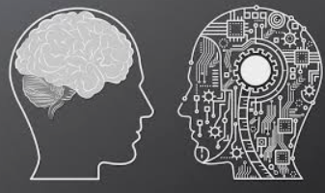
Project Assets
and AI Alternatives
Text
Videos
Narration
Images
Interactions
Structure
Notes:
When we develop our trainings and eLearning there is a lot more than just plain text. Typically, a standard eLearning can have:
Text, in the form of on screen text, scripts, worksheets, tests, guides and other assets that are in a nutshell text.
Videos. And in the videos, there can be text on them, audio, animations, dialogs and other scenarios that can be single character, multi character or simply descriptive without any wording
Narration. You can have one voice, two voices or even more
Images. Which can contain text or not. Like in this presentation
Interactions – Games. Which can be simply pick your answer or full blown Virtual Reality immersive experiences.
And finally of course, any training must have a structure that holds all these assets together

Slide 10

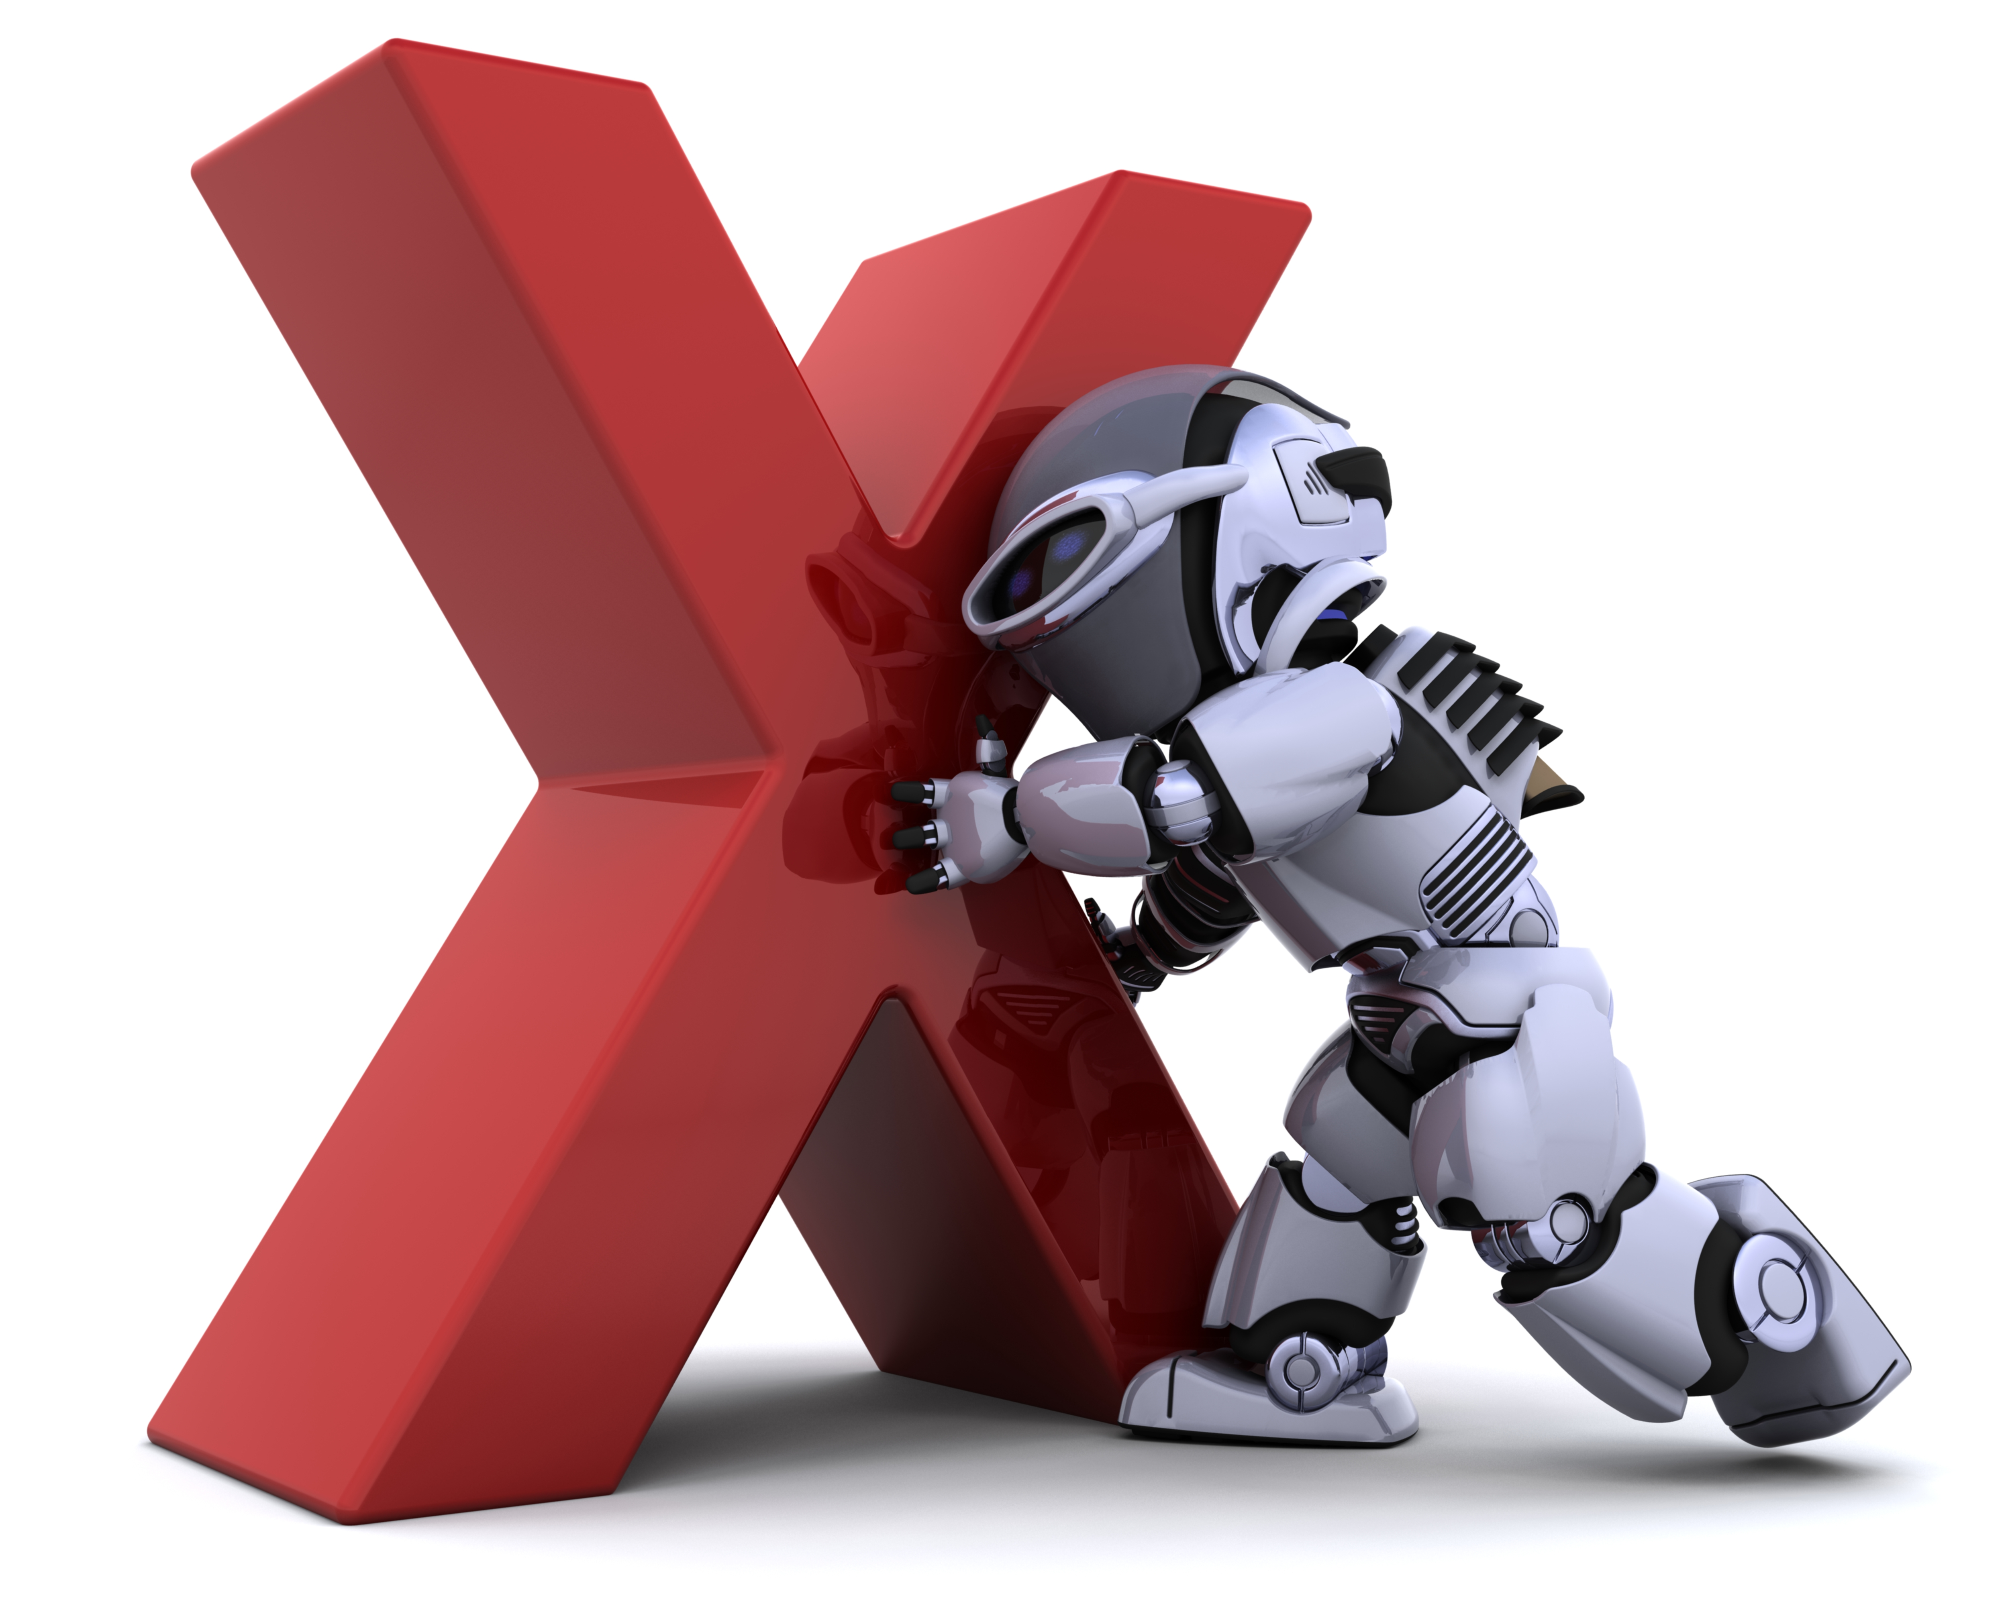
Project Assets
and AI Alternatives
Text
Videos
  Transcription
  Subtitling
  Dubbing
  On-screen text
  Video editing
Notes:
TEXT: For text clearly we have the good old google translate or more recent of course chat gpt which will provide AI translations of our text. When using AI tools to translate our text there are a few things to consider. Number one, if the text is structured in a way that formatting is critical such as when translating Articulate 360 exported files where tags need to be kept intact or PDF files that where created in a different application and then converted to PDF. In these cases, the odds are that a free AI tool (and there are plenty out there) will not maintain the format and create more problems than solutions. There are tools out there like Systran or Deepl which will make attempts to keep the format. Please be advised that some files come out great and some don’t. It depends on how they were created. Also, as you might have guessed, these tools that a bit more robust are not free. So not all AI generated translations are free as some might think.
VIDEOS: In the case of videos, it really depends if the approach will be subtitling or if your plan is a full video editing including translation of all on screen text and dubbing for the audio. Also, the process will change if you have the script in text format or if you need a transcription in order to create a script either to subtitle or to include dubbing in the video.
There are plenty of AI transcription tools but the key is the quality of the audio. Poor quality will likely yield a useless transcript and very likely it will require a thorough human review. Also, AI transcription tools often have a price tag on them as with most AI translation tools.
If you plan to subtitle the videos, you can do an AI translation of the SRT or VTT file and include a translator review. It’s important the translator is familiar with subtitling editing as there are additional factors such as character limitations, break of lines and other unique subtitling nuances. Then there is the video editing process which is a human process. QA and synchronization of the subs in the video is the most important part.
If you decide to use AI voices for the video instead of subtitling, there will be major human editing required. Video editing with professional human voice actors is easier. AI voices will likely lack any emotional intonation and could make the video weird altogether. We don’t advice to use AI for dubbing projects
Then you have the on screen text. These are often short and descriptive, It will be more time consuming to extract them, use AI to translate them and put them back than simply human translate them. So I would say there are no productivity gains here.
And finally you have the video editing part which is clearly a human process.

Slide 11
Project Assets
and AI Alternatives
Narration
Images
Interactions
Structure
Notes:
For narration you can certainly use artificial AI generated voices and that is a space where technology has made a great improvement. Also, a big challenge in this space, specially for professional voice talents, is that the price difference between using AI and voice talents is so large that clients are often tempted to try them. In this same direction, recording technology has improved greatly which makes it easy for anyone to record a fair quality audio. As a matter of fact, many of our clients decide to perform their own narrations due to costs and having their teams potentially listen to a familiar voice on their trainings.
Another important aspect to mention is that even very natural sounding voices can have a hard time with pronunciation of certain words or with very specific industry terms. A trained AI will perform better than a non-trained AI and even then there are very high chances that the target audience will be able to know if it’s AI or Human. Some will not care, but some might see this as a cutting corners approach. This is why it’s important to know the audience.
IMAGES: Like with on screen text. Images with text will likely have just a few words in them. It is often more time consuming to extract run the AI and copy and paste than do a human translation.
The last two pieces we identified in our eLearning which are Interactions and Structure could be a bit of a mix. You can use an AI created template for any interaction or even for an entire presentation or eLearning. You could also use one of the hundreds of interactions provided in Storyline and Rise or one of the many templates available in these authoring tools. However, in all cases, you will need to customize and provide the instructions to guarantee the course itself is the way you wanted.

Slide 12


Best Content Types for AI Success
Structured Content vs Creative Content
Low
Quality
High
Quality
Low
Quality
High
Quality
Notes:
When we talk about types of content we are not necessarily talking about industry specific content although that will certainly play a part, in this case we are talking about the type of content in our training or eLearning from a few angles.
Is this course about a new software?
Is this a sales training course ?
Are we creating a video on how to make Caesar salad or an eLearning on how to tackle tough conversations with low performing employees?
The ideal scenario is one where we should perform a test and see the results on how the content performs in our various AI tools. In reality, this is hardly ever possible because of lack of time, lack of understanding of the AI translation tool or maybe our vendor refuses to do this or wants to charge for it, etc. So, let’s assume we don’t have the time or resources to test our content in an AI tool.
There are a few general patterns that will help us make decisions:
Highly structured content AI output is typically better than creative content. An example of an structured content can be a step by step guide to renew your license or how to complete a form. An example of creative content is a training using storytelling or scenarios. To picture this I put those little color speedometers that show red as low quality output from AI and green as high quality output from AI.
And you’ll see that I never put the mark in dark green and that is because, even if the quality of the output is great, there should always be human QA check step.

Slide 13
Best Content Types for AI Success
Hard Skills vs Soft Skills
Low
Quality
High
Quality
Low
Quality
High
Quality
Notes:
Another important aspect when we think about content and if we should use AI or not is the type of skill that you are trying to train on. Is it a hard skill meaning job specific such as learning how to enter an order on your software or a soft skill which is not job specific such as how to be a better communicator.
Hard skills content tends to yield a better output than soft skills content. The reason for this is because in hard skills training the context is usual very clear but in soft skills context can be more permeable to interpretation. This can lead to confusion for any AI engine.

Slide 14
Best Content Types for AI Success
General vs Technical/Specific
Low
Quality
High
Quality
Low
Quality
High
Quality
Notes:
Training content that contains very specific or technical terminology can disorient the AI engine if they don’t have a large enough data set for those terms leading to nonsensical translations. The more general the translations in terms of content and terminology, the easier would be for the AI engine to process and produce better outcomes. You can potentially train the AI engine on your specific terminology by creating a glossary of terms. However, that is a human process that must be included as part of the project.

Slide 15
Best Content Types for AI Success
Good Content vs Poor Content
Low
Quality
High
Quality
Low
Quality
High
Quality
Notes:
Finally and this is something most of you are probably familiar with and it also applies to projects that do not use AI in any step of the process.
Poor original content will create poor translated content. Make sure you are 100% confident that your original content is ready before moving into the globalization phase.

Slide 16
Languages Matter, and So Does Data
Chinese (Mandarin): Over 1 billion native speakers.
Spanish: Around 460 million native speakers.
English: Approximately 370 million native speakers.
Hindi: About 310 million native speakers.
Arabic: Around 310 million native speakers.
Bengali: Approximately 240 million native speakers.
Portuguese: About 220 million native speakers.
Russian: Around 150 million native speakers.
Japanese: Approximately 125 million native speakers.
Punjabi: About 100 million native speakers.
German: Approximately 90 million native speakers.
Notes:
On this slide I have included the 11 languages with the highest amount of speakers. They account for about 40% of the world’s population. Please keep in mind that there are 7,111 languages so the reminder 60% of the world speaks 7,100 languages.

Slide 17
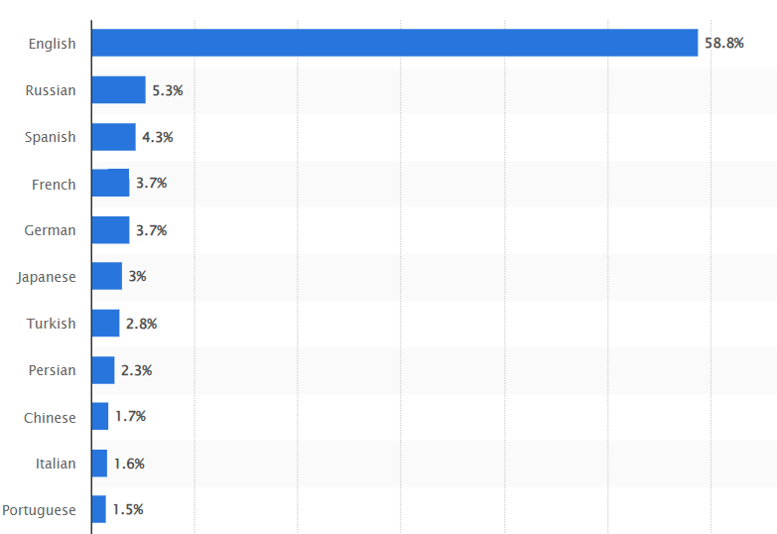
Languages Matter, and So Does Data
Notes:
When we look at the distribution of online content, the picture is quite different. English accounts for about 60% and the next contender Russian, for about 5%. What this tell us is that there are huge amounts of data to feed the AI machinery in English. Even combining the amount of content produced by the other 10 languages it doesn’t even come close. If your global training project has several languages, you need to know that for some the AI outputs will be great but for others less so and in some cases AI might be simply unavailable.

Slide 18
AI-Driven Strategies for Global Trainings
The impossible triangle: quality, price and time (pick two)
Assets: text, video, narration, images, interactions and structure
Content: structured or creative, soft skills or hard skills, general or technical/specific, overall quality
Languages
Notes:
Now that we have talked about all the things to consider when using AI on your global trainings. Lets recap so we can implement some of this on our next global trainings.
The impossible triangle. Laydown what are the potential problems early. Do you have a set deadline that is approaching, are the stakes high? You have a limited budget so you are inclined to use AI in the process? Quality, Price, Time. Rank them in importance.
What are the assets I will use in my training. text, video, narration, images, interactions and structure. Are you creating a simple text Rise course. More AI friendly. Does your course contain lots of videos, narrations, interactions, less AI friendly.
Last year we did a webinar about why eLearning fail for international use. In line with this, it’s critical to know what type of Content you are creating? structured or creative, soft skills or hard skills, general or technical / specific.
Is this the how to use our software course or scenarios about how to deal with an angry customer? Are you providing a technical sales enablement course with lots of technical terms or training on how to fill an intake form. Very technical or general overall? Technical less AI friendly, general more AI friendly.
Then are you happy with the quality? Is your course a killer or it could use some work. Remember that poor original content will yield poor translated content more so when using AI.
Finally what are the languages? Is this a multilanguage project? Expect that AI output for some languages will come out better than others. Do you need to launch the course in a language you’ve never heard off? Maybe AI is not a great idea.

Slide 19
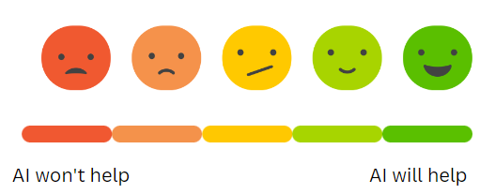
A Couple of Scenarios
Simple Rise course text and narration
Time and cost-efficiency critical
Content (how to change a tire)
Only translated to Spanish
Notes:
Here lets talk about a couple of scenarios:
Simple Rise course text and voice over (both have AI alternatives). We are told we need it by next week and budget is tight this quarter (same parameters as last quarter).
Content is general and fairly simple. Language is Spanish with decent amount of data.
After our preliminary evaluation we can place this project in the AI will help side of the scale

Slide 20
A Couple of Scenarios
Multi-asset course with text, videos, narration and interactions
CEO’s office will oversee the success of the project
Quality and time critical
Content (how to change the tire of a plane)
Translated into 12 languages
Notes:
Now a different scenario:
A course containing text, videos, narration, interactions. Our new CEO’s focus is on emerging markets. They will be on our back.
Content is more complex and has airplane specific terminology and you are tasked to put it out in 12 languages.
You can potentially try to use AI in some languages but it might not be worth the effort.

Slide 21

Tips
What AI struggles with and more
Context errors
Idioms and cultural nuances
Tone and politeness
Word play and puns
Gender and pronouns
Technical terminology
Ambiguity
Homonyms and homophones
Long or complex sentences
Tools
You can train the machine
Keep the human on the loop
Notes:
Thanks to our wonderful production team he have evaluated about a half dozen AI translation engines including Google Translate, Amazon Translate and Chat GPT as well as several AI tools to create automated voices, transcriptions and subtitles and we found that in general AI outputs have the following flaws. I should also say that I validate this by asking Chat GPT:
Context Errors: AI translation systems struggle with understanding the context of a sentence which leads to translations that might be technically correct but don't convey the intended meaning correctly. AI lacks a deep understanding of the world, so it can misinterpret ambiguous terms or phrases that a human would easily understand based on context. Take the word shot. Are we at a bar? Party context. Who’s been shot? Gangsta context. My baby needs to take a shot. Medical context
Idioms and Cultural Nuances: Idioms, metaphors, and cultural references can be difficult for AI engines. These expressions are very often specific to a particular language or culture and in most cases don’t have direct equivalents in the target language.
Tone and Politeness: Different languages have different levels of formality and politeness. AI might not accurately capture the intended tone, especially when translating between languages with vastly different levels of formality, like Spanish or Japanese and English.
Word Play and Puns: Wordplay, puns, and jokes that rely on language-specific double meanings can be extremely challenging for AI to translate effectively. The humor or cleverness of such content can get lost in translation.
Gender and Pronouns: Some languages have gendered nouns and pronouns, while others don't. AI might incorrectly assign gender when translating between languages with different gender structures, leading to awkward or inappropriate translations. Take the word CEO for example. We tested an engine that always translated the term CEO as a male in several languages. Clearly this can be offensive.
Technical and Specialized Terminology: AI might struggle with highly technical or specialized vocabulary, resulting in incorrect or nonsensical translations in fields like manufacturing, medicine, law, or science.
Ambiguity: Ambiguous sentences can confuse AI translation systems, as they might choose the most common interpretation rather than the intended one. This is particularly problematic when precise meaning is crucial.
Homonyms and Homophones: Words that sound the same but have different meanings (homonyms) or words that are spelled differently but sound the same (homophones) can lead to translation errors.
Long Sentences or Complex Phrases: Longer sentences or complex sentence structures can challenge AI translation systems, resulting in fragmented or convoluted translations.
Tools: Quality output varies substantially depending on the AI tool used and some tools are better at some context, some others are better depending the language. It’s a good idea to evaluate a few available tools and see cost and quality balance. In that sense, I will be happy to make suggestions based on your project so feel free to email me. I will post my email on the Q&A slide if you don’t have it.
AI tools are a bit like pups. You can train them: Many AI tools, can be trained to use your preferred terminology and style. It takes time and data input but if you work with a lot of global content it’s worth it.
Keep the Human on the loop: Use AI tools without review at your own risk. Your strategy should always include a human review whether you use an AI translation, AI transcription or an AI voice. AI should be treated as a productivity tool and that is when it becomes a competitive advantage in the development of trainings, using it as a replacement of professional human work is a risky approach.

Slide 22

Q&A
EMAIL: sergio@ideatranslations.com

Slide 23

