Slide 1

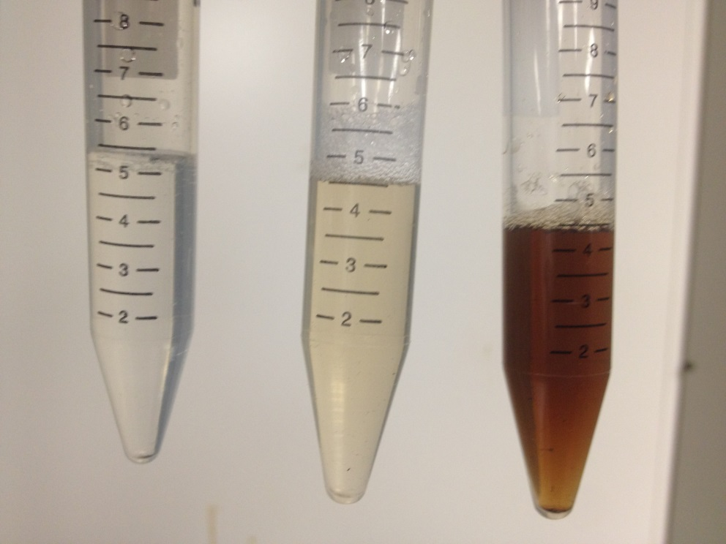
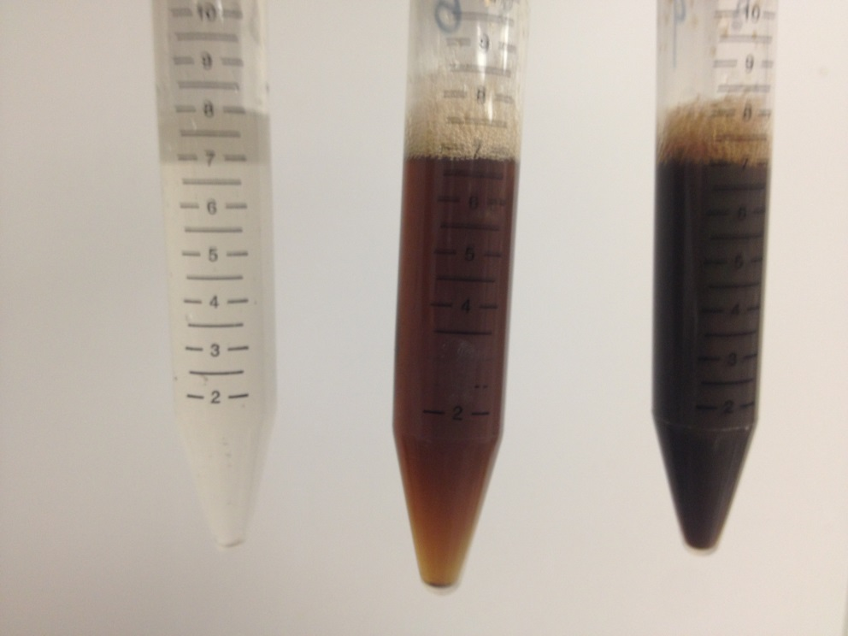
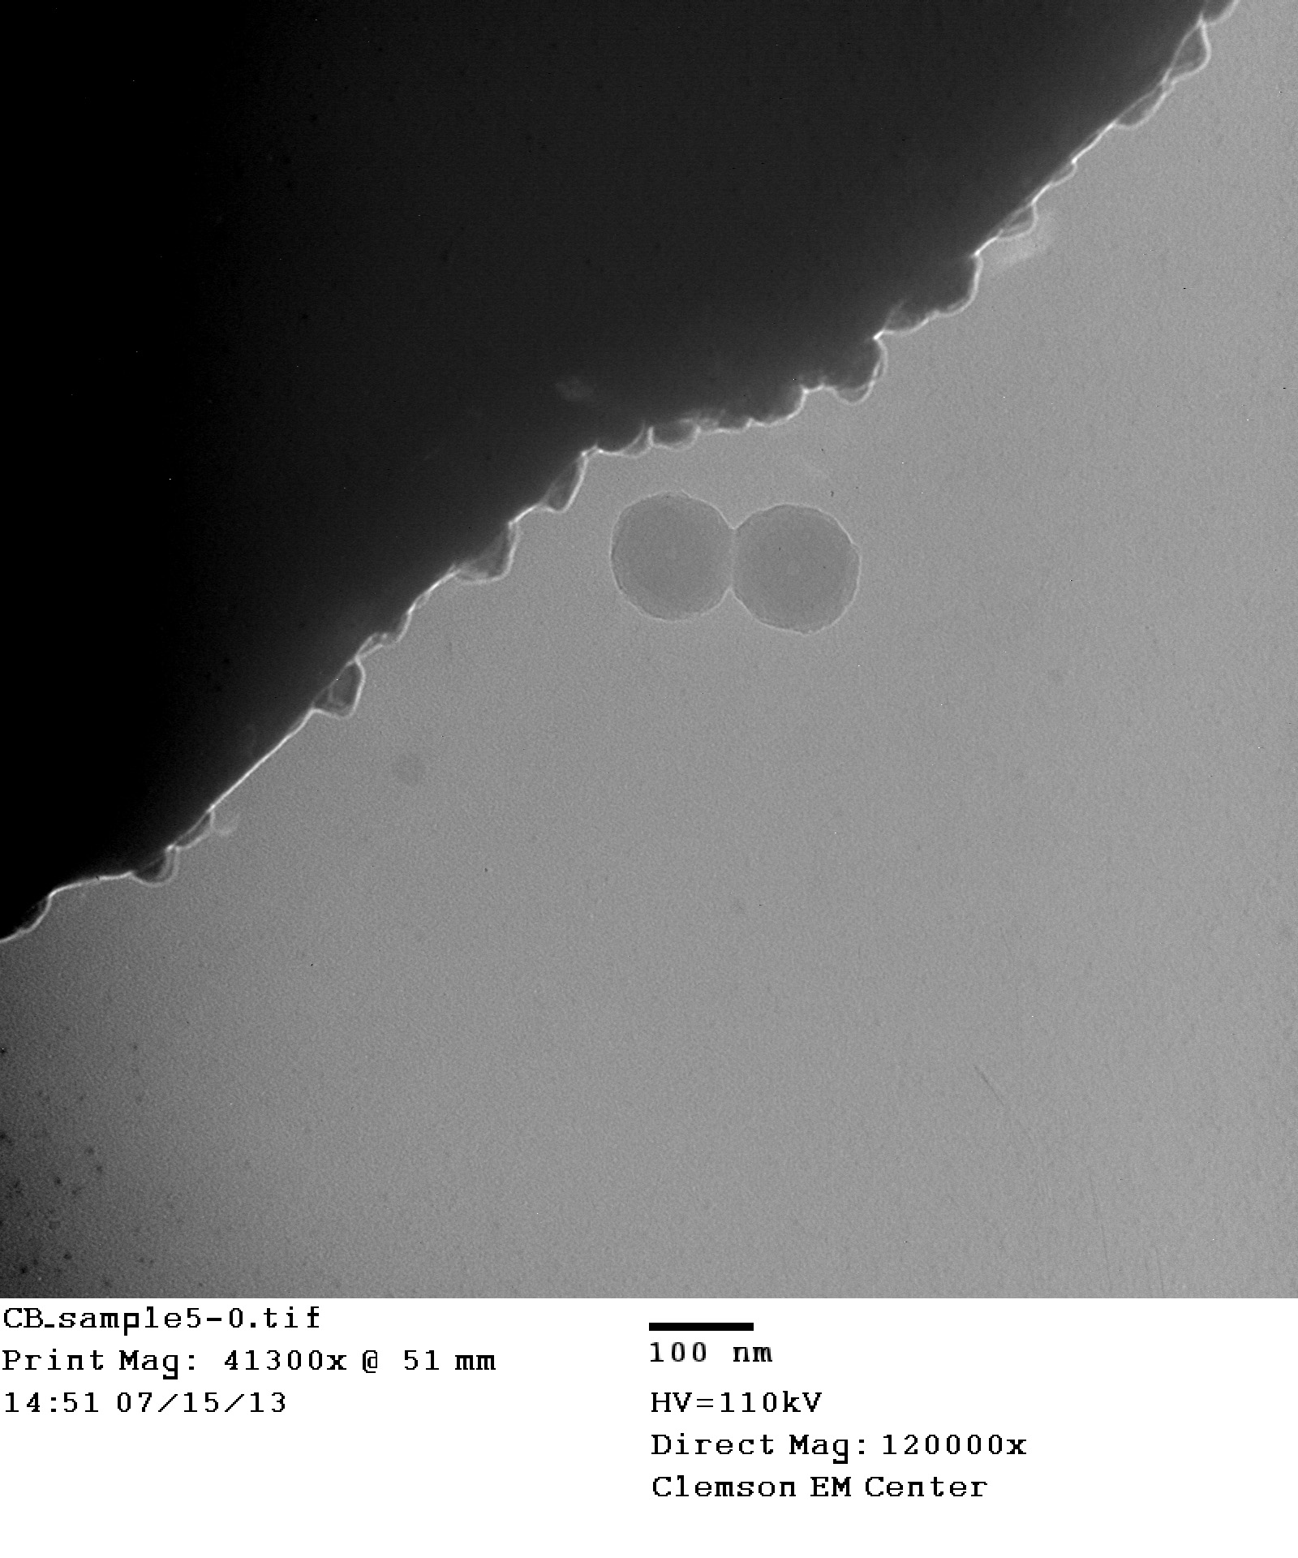
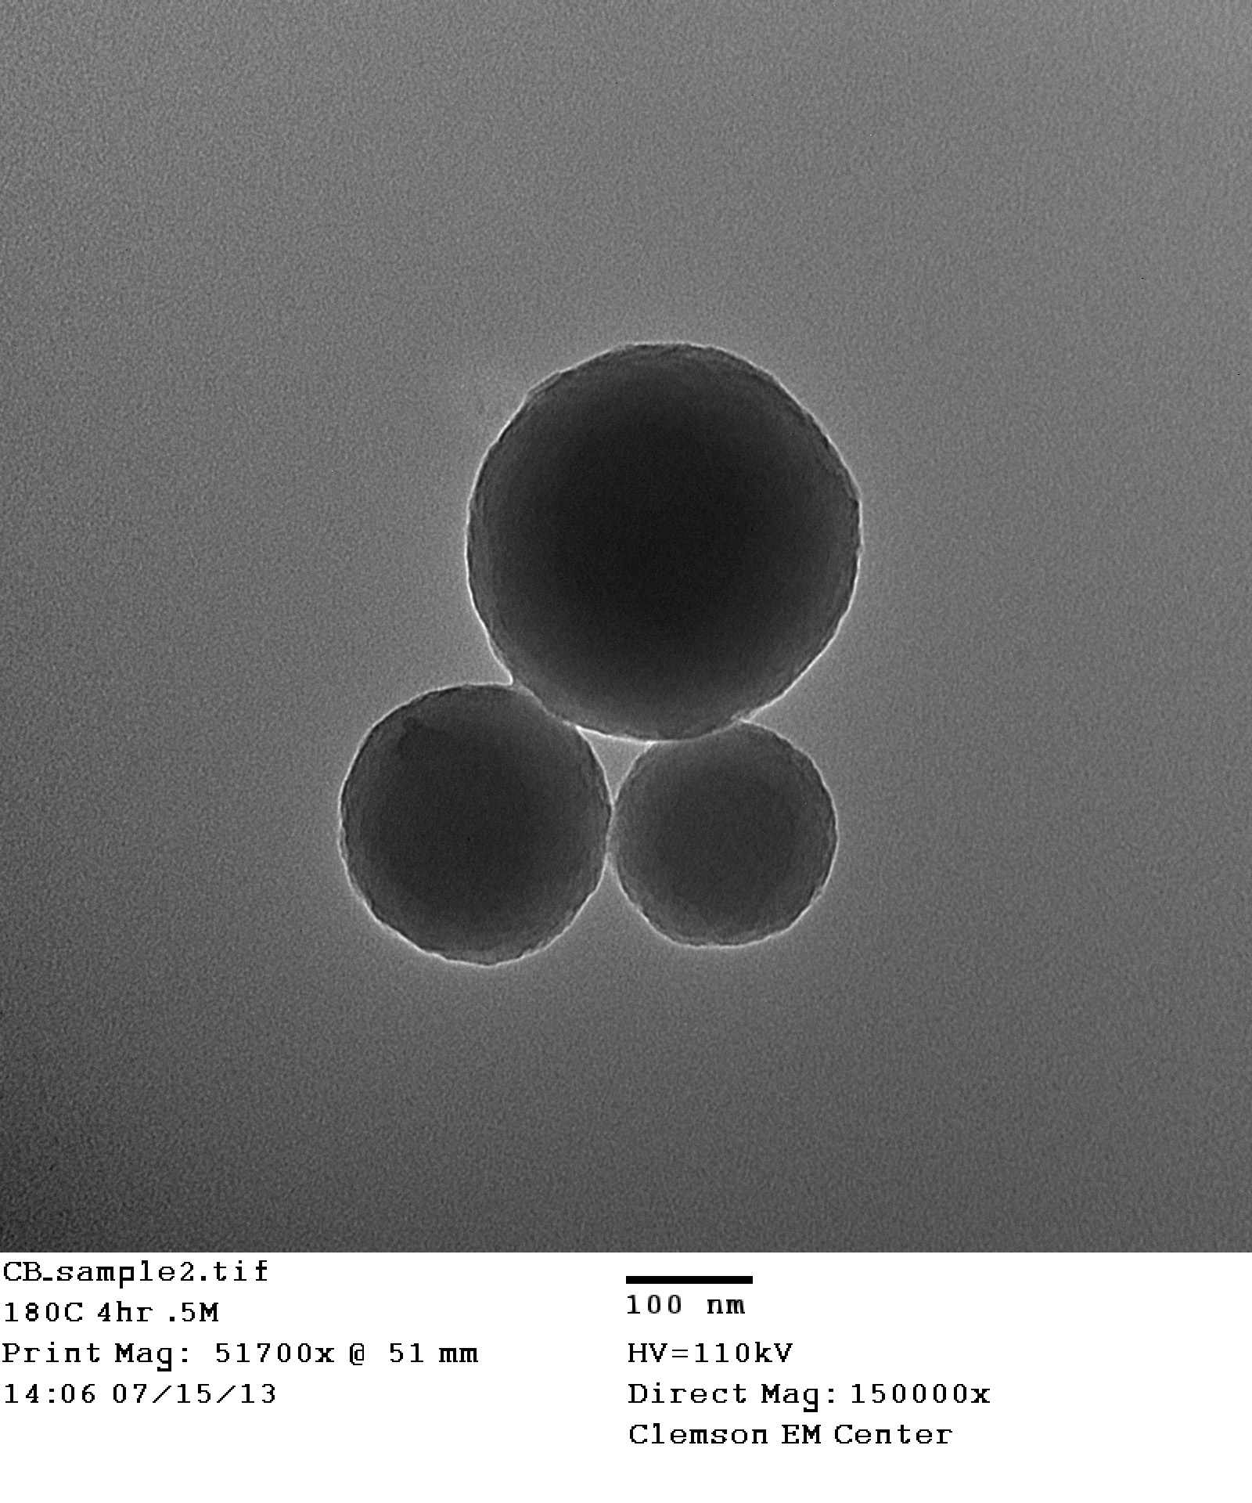
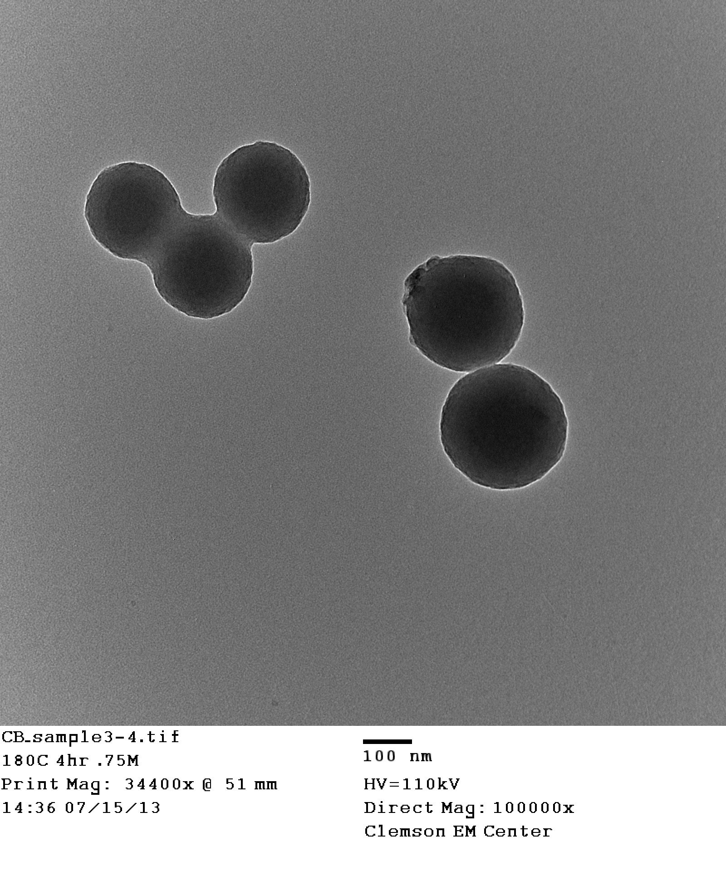
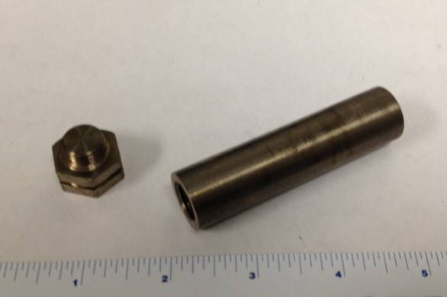
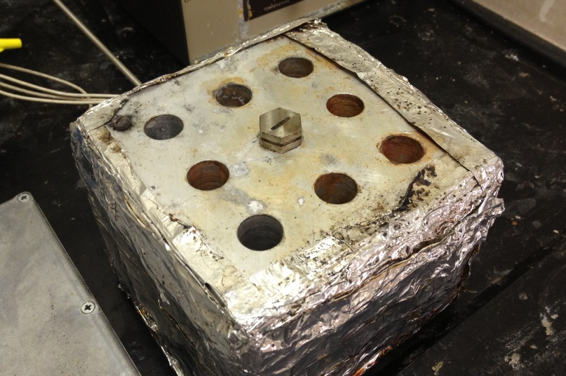


Radiolabeled Carbon Nanospheres as a Model Adsorbent for Superfine PAC in Membrane Breakthrough
Connor Bilchak,
Erin Partlan, David Ladner
Department of Environmental Engineering and Science
CLEMSON UNIVERSITY
Introduction
Results and Discussion
Results and Discussion Cont.
Superfine Powdered Activated Carbon (S-PAC) is useful for selective adsorption of trace contaminants in competition with natural organic matter
S-PAC is removed by membranes, but breakthrough is difficult to measure
Labeling of a model compound with radioactive isotopes presents the opportunity to observe breakthrough on a small scale
Synthesized carbon nanospheres are useful as a model adsorbent and for the ability to be radiolabeled
Figure 2: Comparison of particle diameters produced with varying concentrations, heating times, and temperatures.
Figure 5: Comparison of carbon nanosphere rejection by membranes of various pore sizes; MWCO=Molecular weight Cutoff
Objectives
Carbon nanosphere breakthrough trends:
Smaller pore size membranes rejected increased particle mass
250kDa membrane rejects 99% of radiolabeled particles
Determine production parameters for high yield of 300-500 nm diameter nanoparticles with spherical morphology
Measure membrane breakthrough of S-PAC using Carbon-14 (¹⁴C) labeled synthesized nanospheres
Characterize nanosphere adsorption of ¹⁴C Atrazine
A B
Figure 3: Diluted Nanospheres prepared at (A) 160°C for 6 hrs and (B) 180°C for 2 hrs, arranged by increasing concentration. The effect of temperature and concentration on yield can be clearly seen.
Experimental Methods
Synthesized carbon nanosphere trends:
Increasing temperature increased particle yield
  200°C attempted, but did not yield individual particles
Increasing concentration also increased particle yield and slightly increased particle diameter
Increasing time produced larger particle diameters
  2 and 4 hr samples gave similar particle size; 6 hr samples displayed very large particle diameter
  160°C at 2 hrs did not produce measurable yield
Glucose solution containing ¹⁴C tracer in custom 5 mL titanium reaction vessels and subjected to hydrothermal reaction conditions of 160°-180°C for 2-6 hrs using aluminum heating block
Nanosphere product centrifuged and washed with water and ethanol in preparation for DLS and TEM measurements to characterize nanosphere diameter and morphology
Nanospheres diluted with 20 mL DI water and filtered using syringe disk filters
Atrazine adsorbed with 2mg of varying adsorbents
Radioactivity of solution before filtering and filter permeate measured using liquid scintillation counter
Figure 6: Comparison of atrazine adsorbance by S-PAC and carbon nanospheres. Particles activated by shaking with 1M NaOH overnight.
Atrazine adsorbance Trends:
S-PAC shows substantially higher adsorbance
Particle activation produced minimal added adsorbed mass
A B C
Conclusions
Carbon Nanospheres containing ¹⁴C function as suitable model for S-PAC breakthrough, though are of limited use for simulating adsorbance of synthetic organics
Microfiltration membranes remove nanospheres on a level sufficient for drinking water purposes
5 cm
100 nm
100 nm
100 nm
Future Works
Construction of atrazine adsorption isotherm using synthesized carbon nanospheres
Explore alternate nanosphere activatation methods
Characterization of S-PAC aggregation kinetics and methods to induce aggregation
A B
Figure 4: T.E.M. Images of samples; (A) 160°C, 6hrs, .75M (B) 180°C 4hrs, .5M (C) 180°C, 4hrs, .75M
Figure1: (A) the titanium reaction vessels and (B) aluminum heating block used to achieve hydrothermal reaction conditions.
Morphology consistent throughout all tested particles
Diameter range of 200-400nm similar to that of S-PAC
Acknowledgements: The Authors thank Dr. Thompson Mefford and his research group for providing the titanium reaction vessels and aluminum heating block. This work was part of the Advanced Functional Membranes Research Experiences for Undergraduates program at Clemson University. Support for this REU program was provided by the National Science Foundation under award EEC 1061524. Visit our website at www.clemson.edu/ces/chbe/reu/index.html

