Slide 1
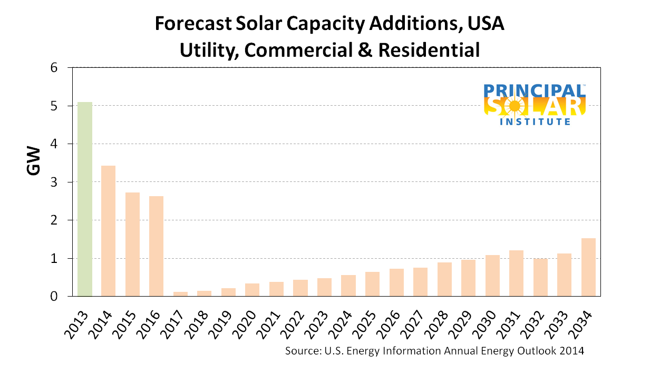
The US Energy Information Agency forecasts a precipitous drop in additional solar capacity at the end of 2016, largely due to the end of Investment Tax Credit (ITC). If this forecast holds, there will be a tremendous impact on solar businesses in the USA. Since more than 95% of the annual solar capacity additions are residential, this sub-segment will likely suffer the greatest. The economy of scale afforded to large commercial, community, and utility-scale solar may offer them some protection.

