Slide 1
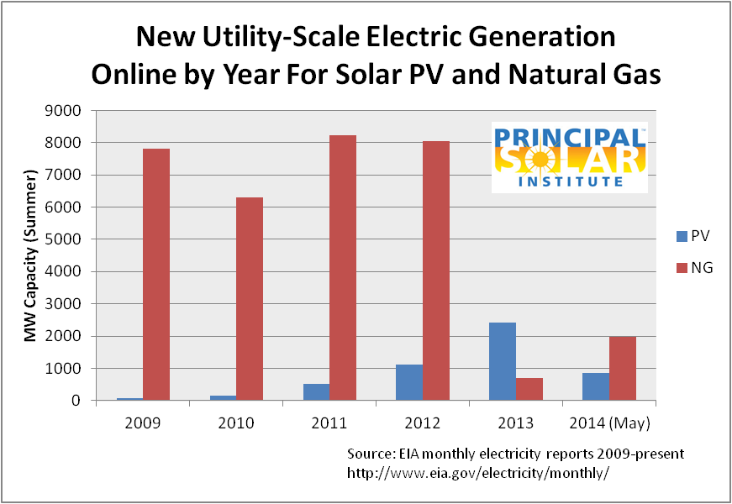
A comparison of new utility-scale electric generation capacity. The prevalence of natural gas power plants is well understood, but it is also notable that utility-scale solar PV has grown into a non-trivial component of the US new power generation. You should contact the Principal Solar Institute to suggest other interesting comparisons.

